Slide 1


Agricultural Mechanics 101: Beginning Shop Projects for nEw teachers
Dr. Ryan Saucier, Dr. Rick Ford, Devin Vecera

Slide 2
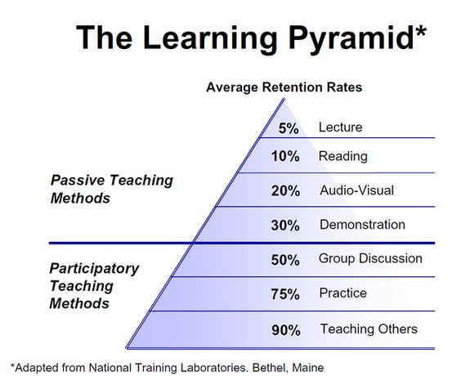
How do students retain learning?

Slide 3
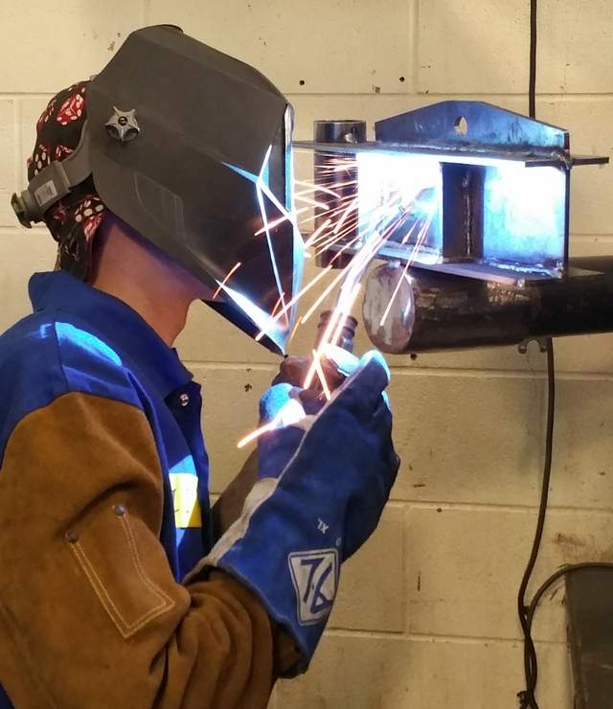
For effective Ag Mechanics instruction:
  students need prior knowledge
  terms, principles, theory
  students need a balance of academic study and laboratory activities
  THINK, SEE, DO!

Slide 4
How to TEACH Agricultural Mechanics?
TEKS
Scope and Sequence
5 P’s
Safety
Skill Development

Slide 5
Chapter 130 of the TEKS
Know what you should teach (SCOPE)
You decide the sequence and the time
5 P’s – Prior Planning Prevents Poor Performance

Slide 6
Safety Education
Should happen every year even for continuing students
Consider integrating OSHA 30 hour card into your safety plan (CERTIFICATION)
Safety education should be a continuing subject

Slide 7
Recommended Safety Documents
Student/Parent/Teacher signed Safety Contract
General Safety Exam (100% pass rate)
Tool Specific Safety Exam for every tool used (100% pass rate)
Student Tool Demonstration
All these must be documented and kept on file for 5 years

Slide 8
Skill Development
Prior to project construction…
Consider teaching ag mechanics skills
Skill Demonstration to Students
Students then Demonstrate the Skill
Skill Sheet

Slide 9
What is a Skill Sheet?
Typically one page and includes:
Title
Bill of Materials
Construction Procedures
Construction Teaches (What are students learning?)
Evaluation Rubric
Can be a single day skill or a multi-day skill

Slide 10
Example of Skill Sheet - SMAW

Slide 11
Examples of Simple Ag Mechanics Projects
TEKS
Promote Learning
How will you evaluate student learning/skill?
Budget?
Timeline?

Slide 12
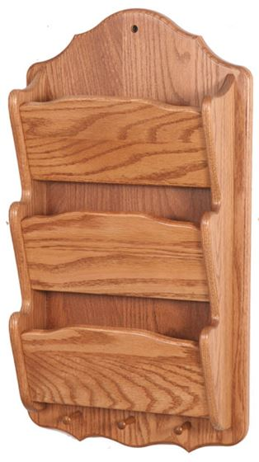
Skill Resources
Lowes
Home Depot
Yella Wood
Wood magazine
Pinterest
Google “shop project plans”

Slide 13
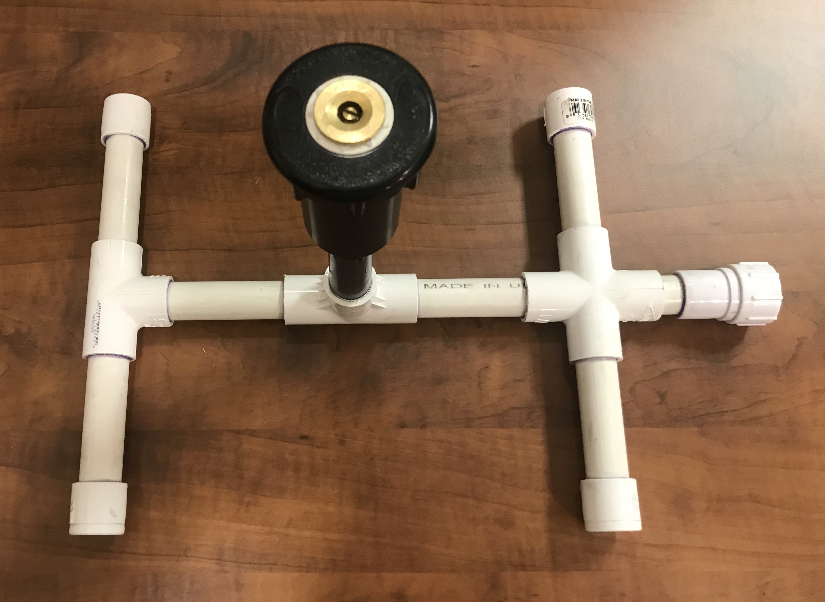
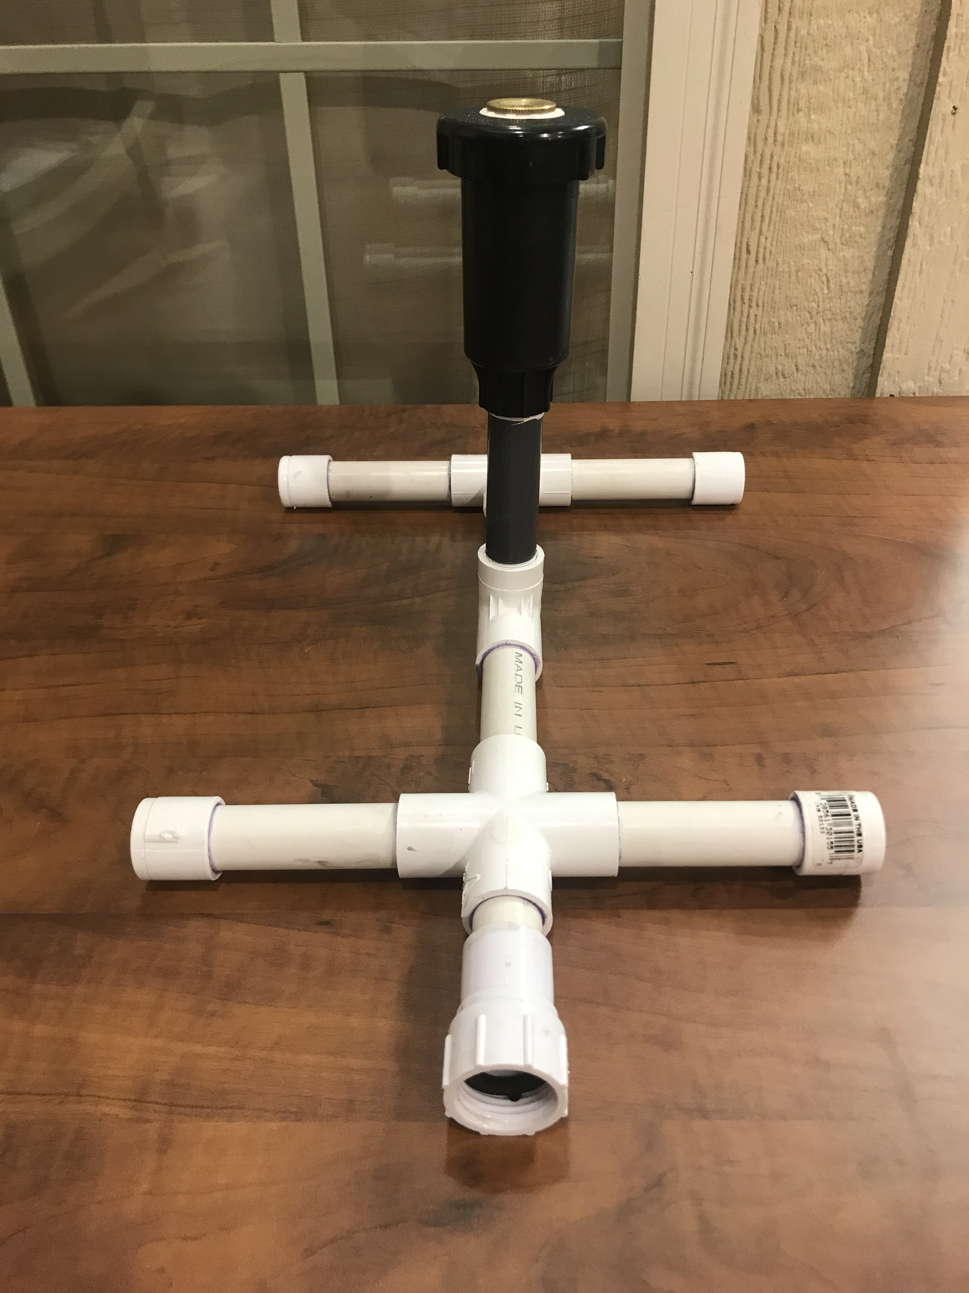
Sprinkler

Slide 14
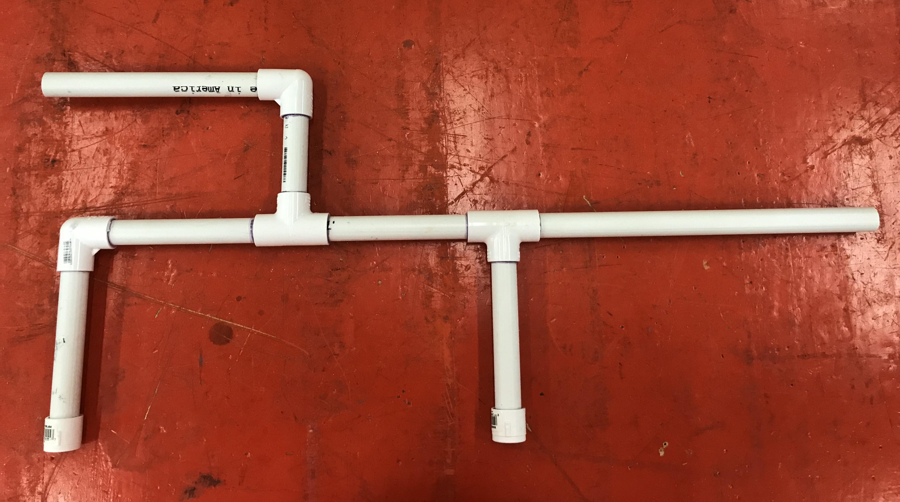
Marshmallow Launcher

Slide 15
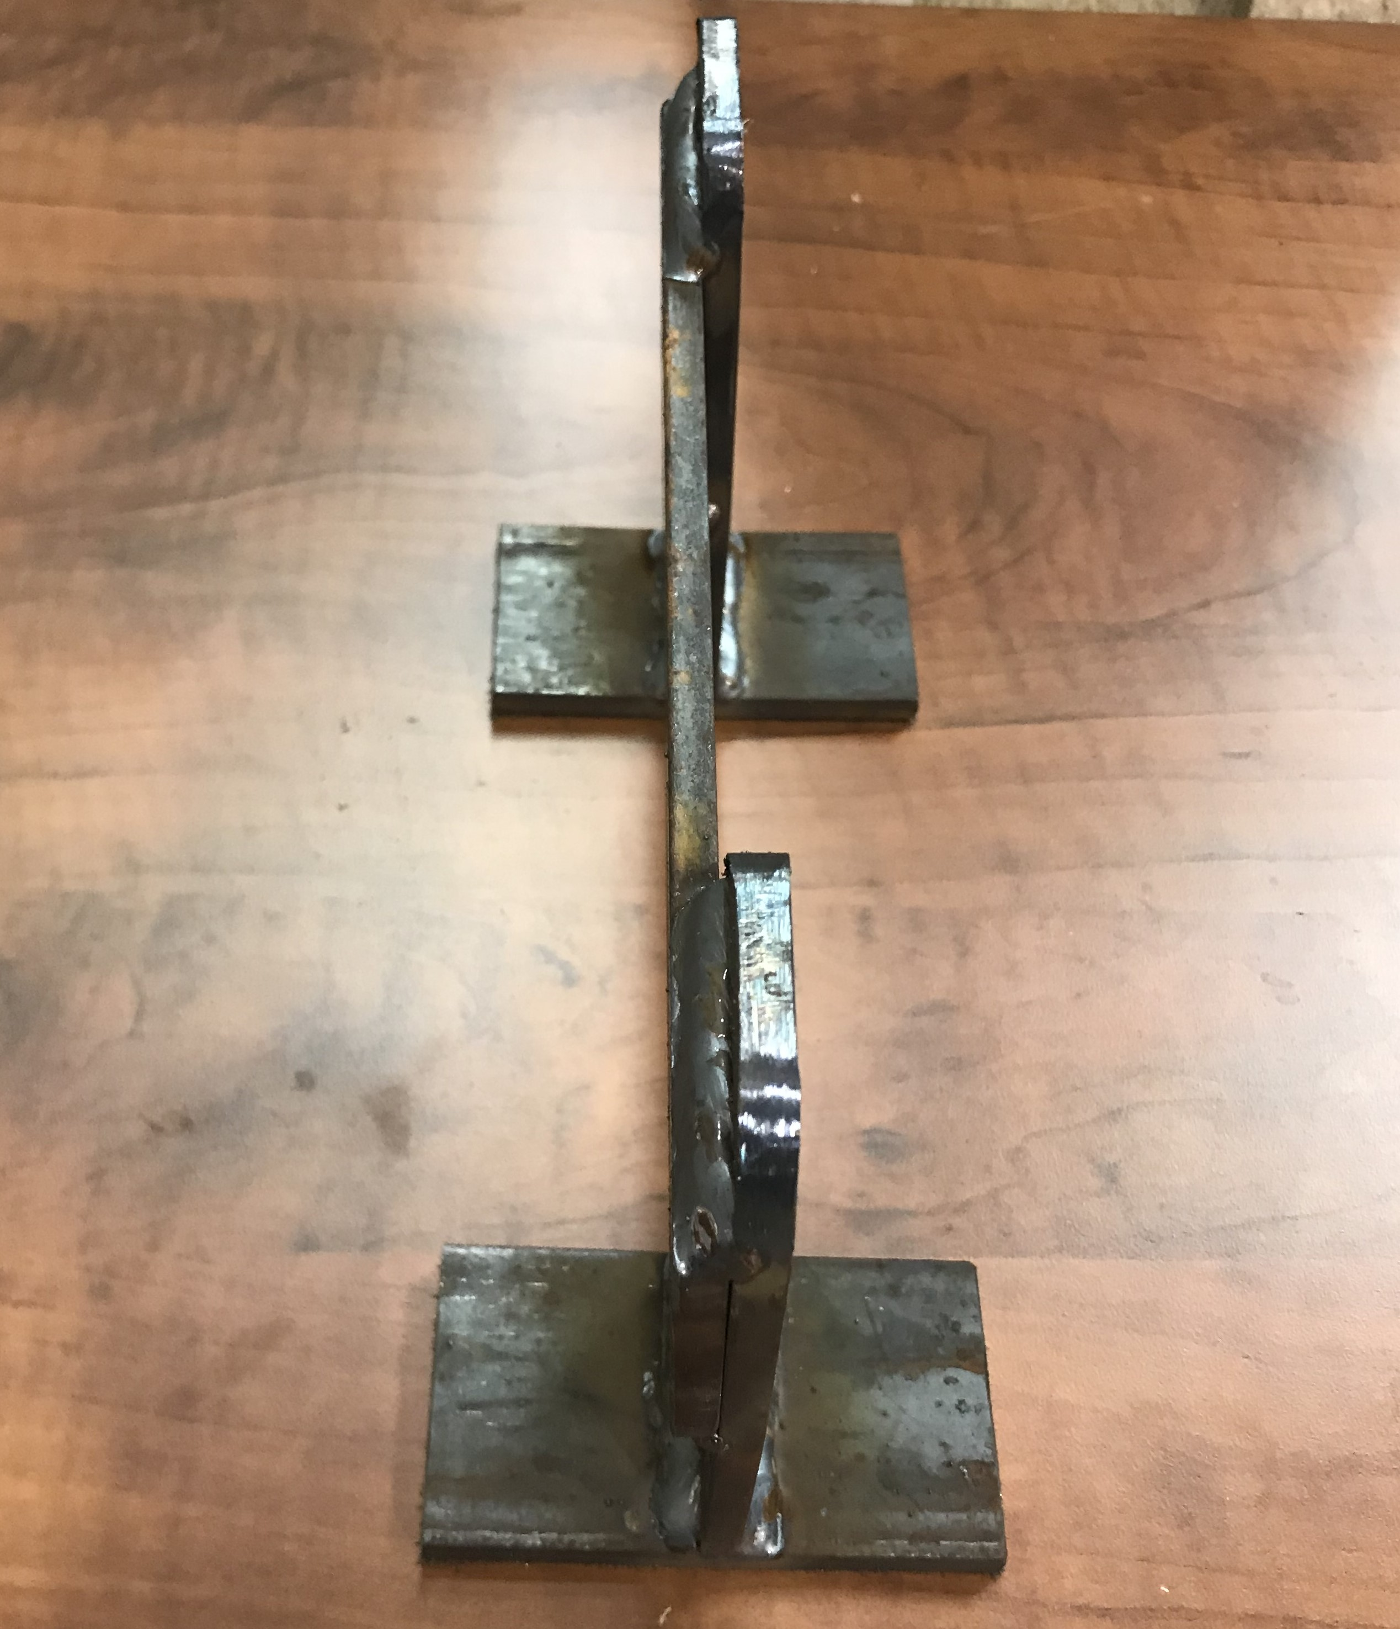
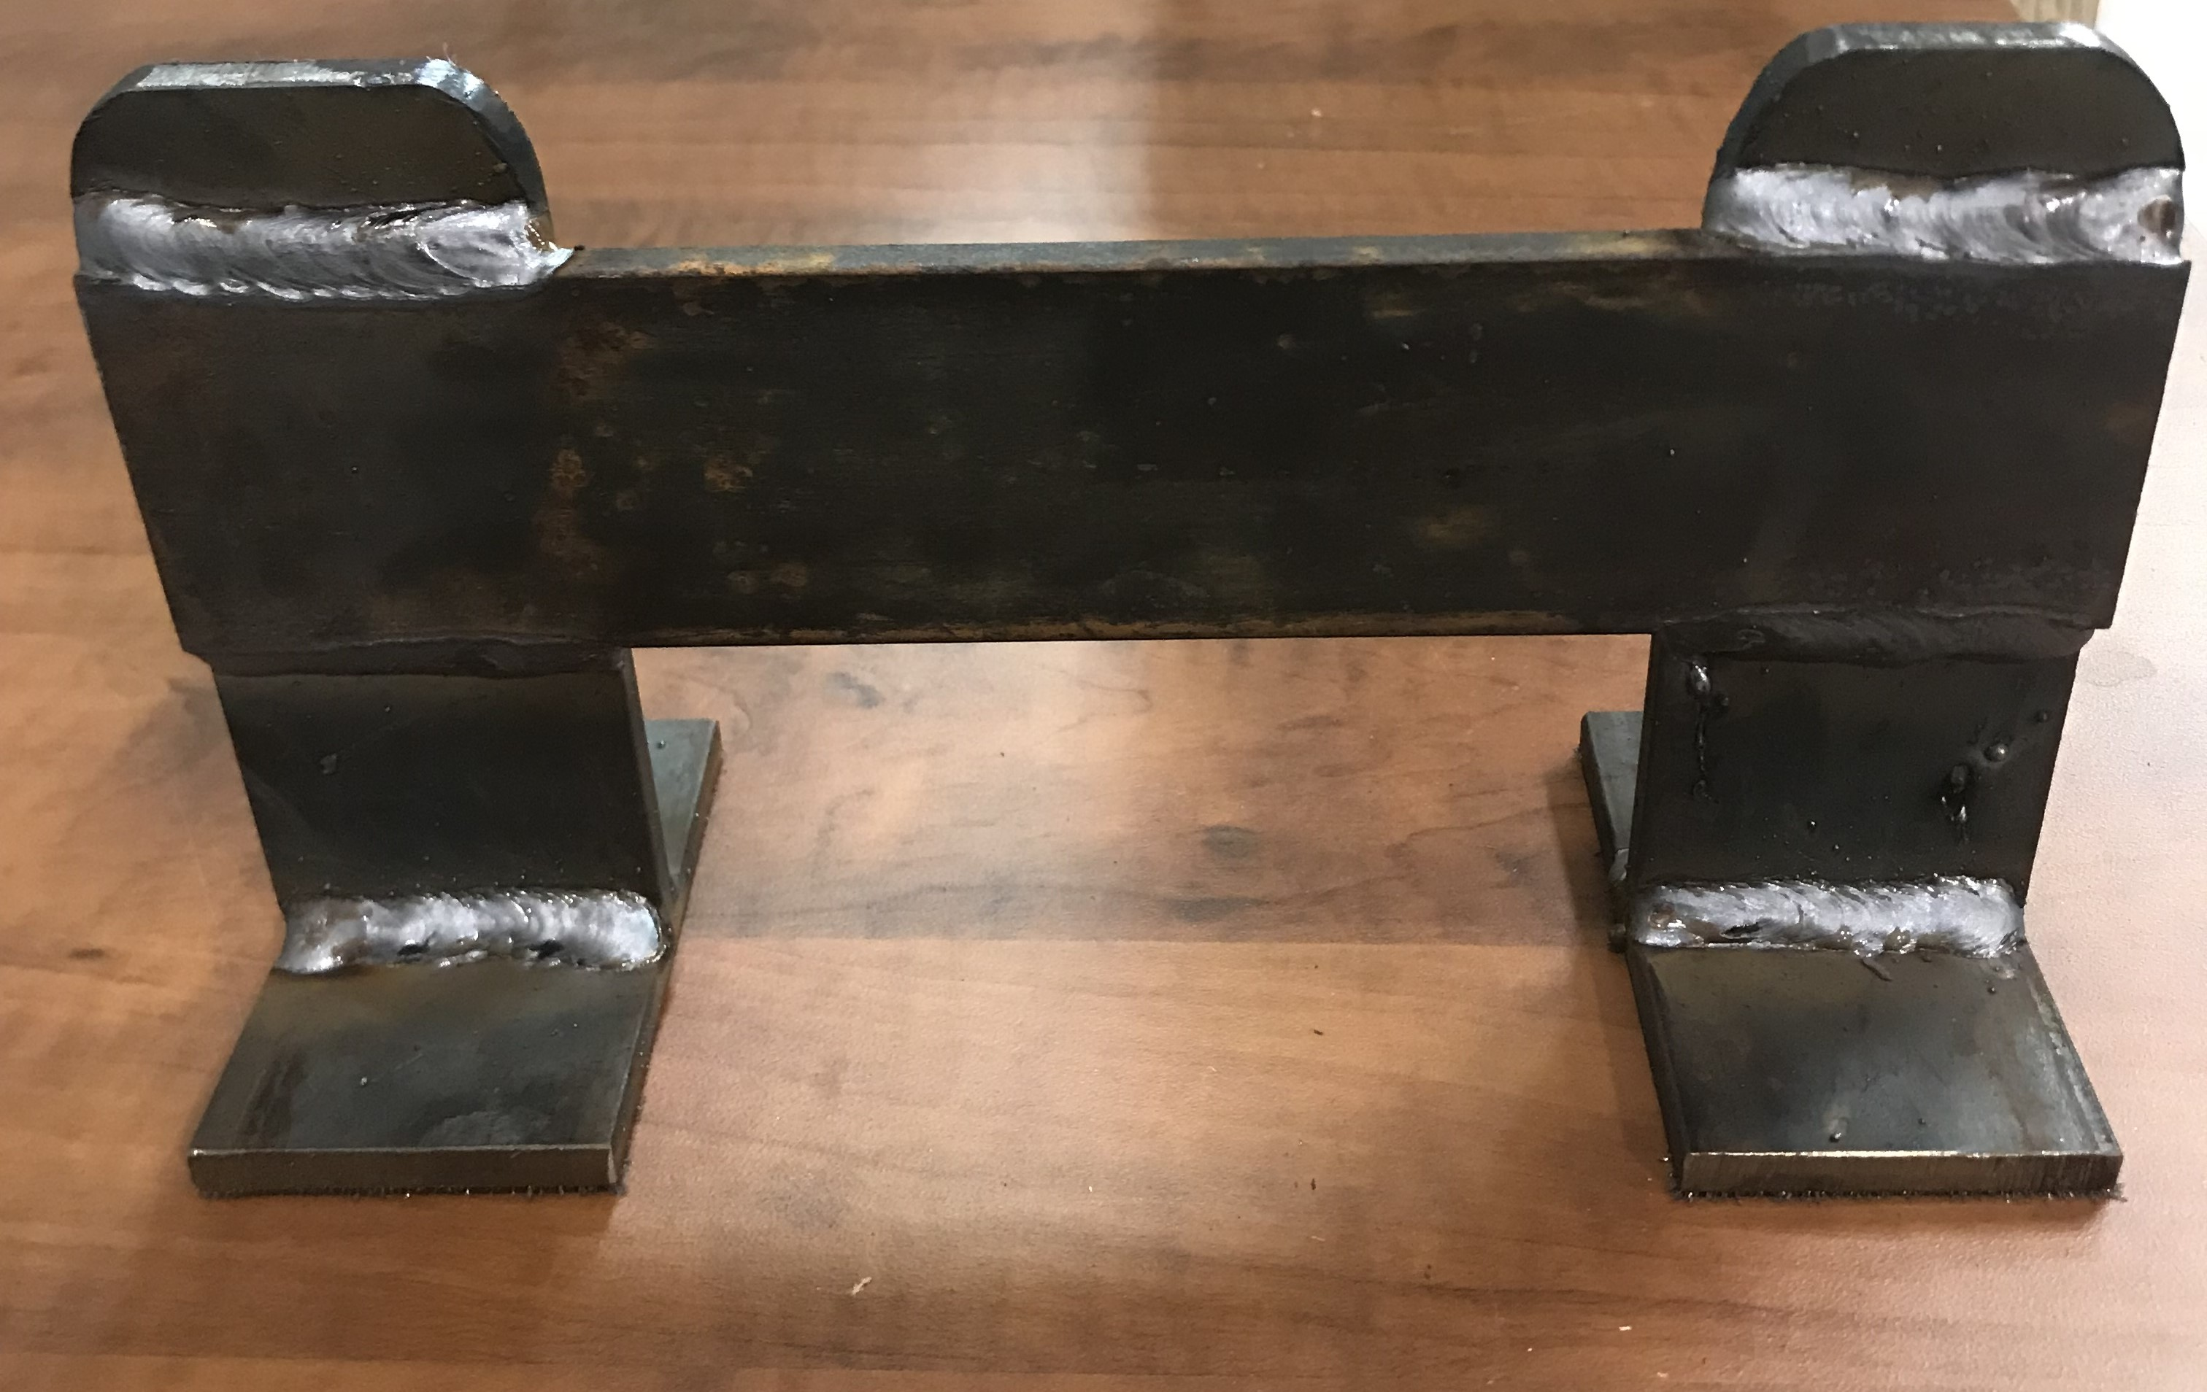
Boot Scraper

Slide 16
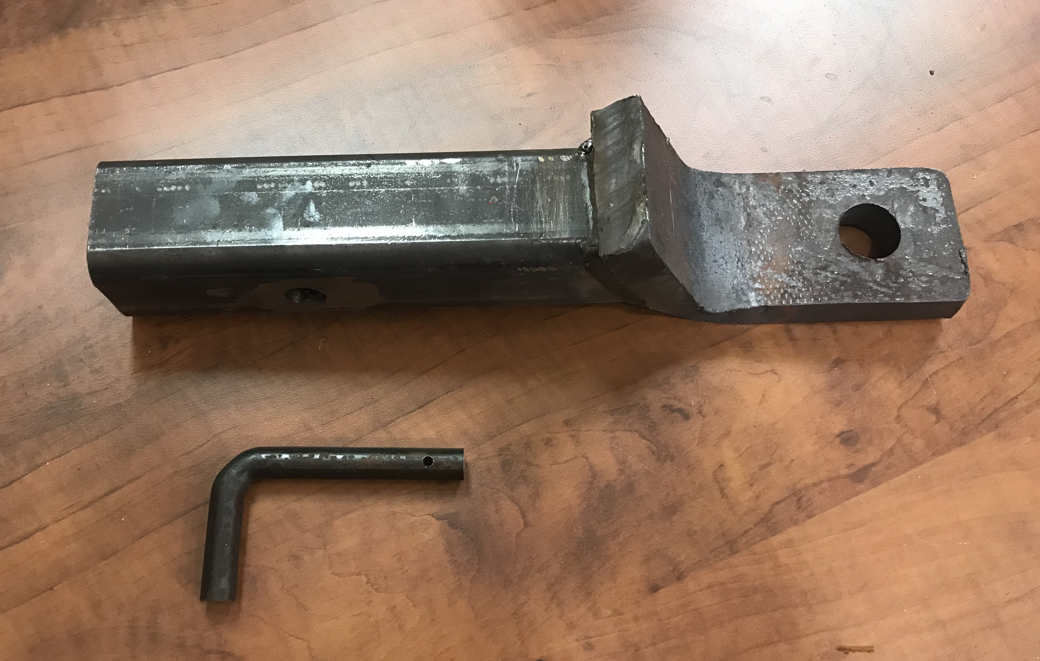
Receiver Hitch

Slide 17
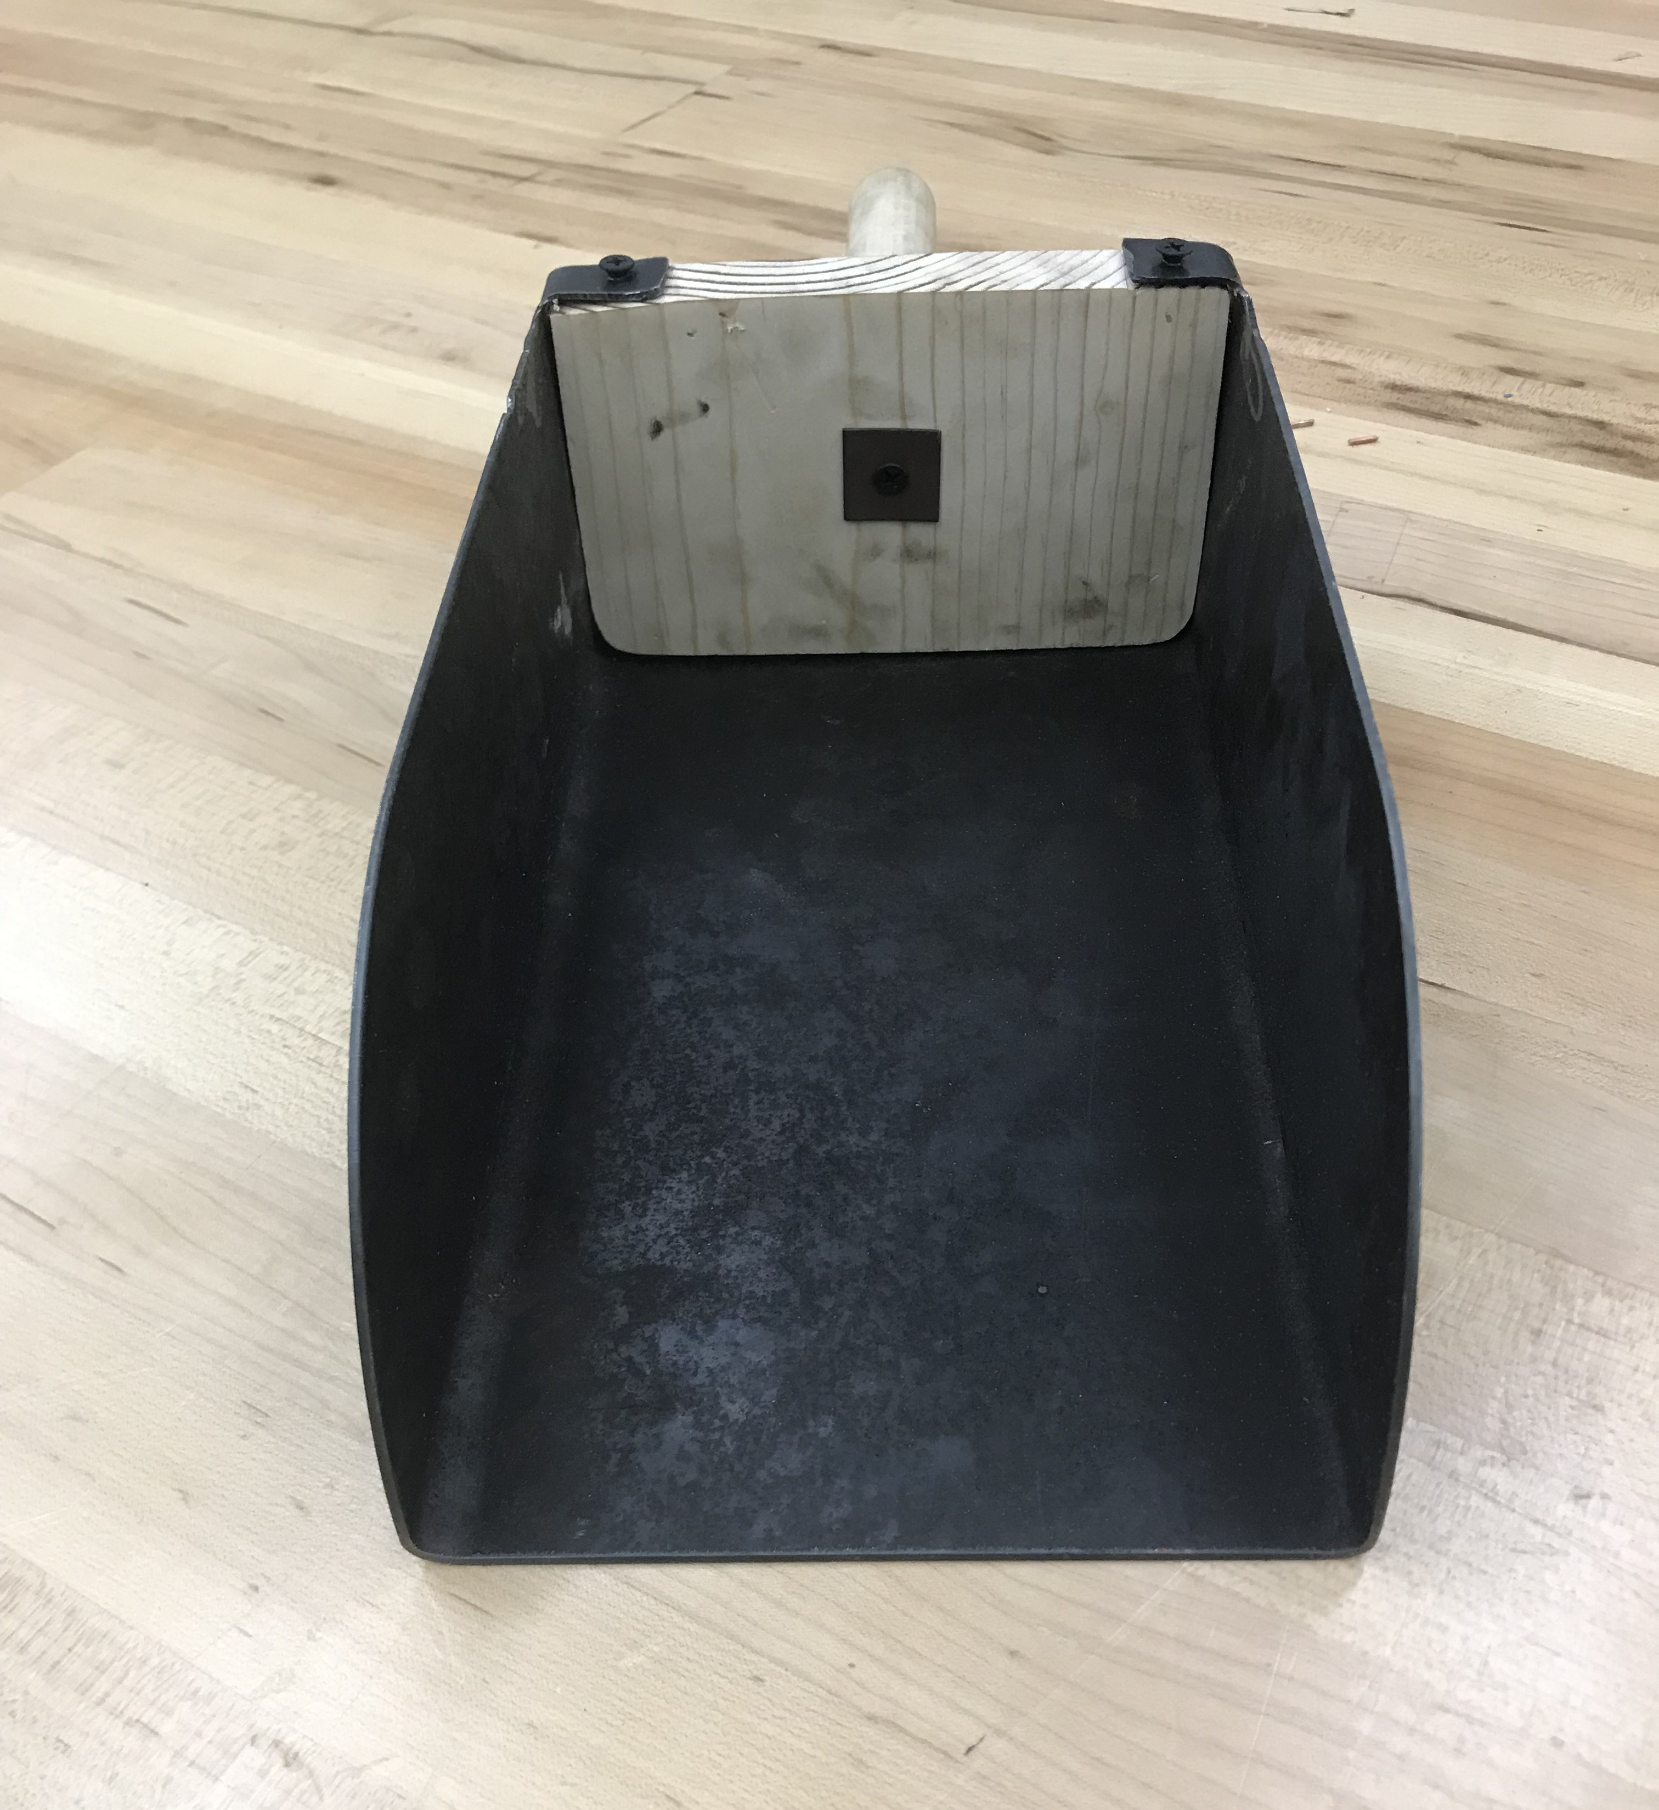
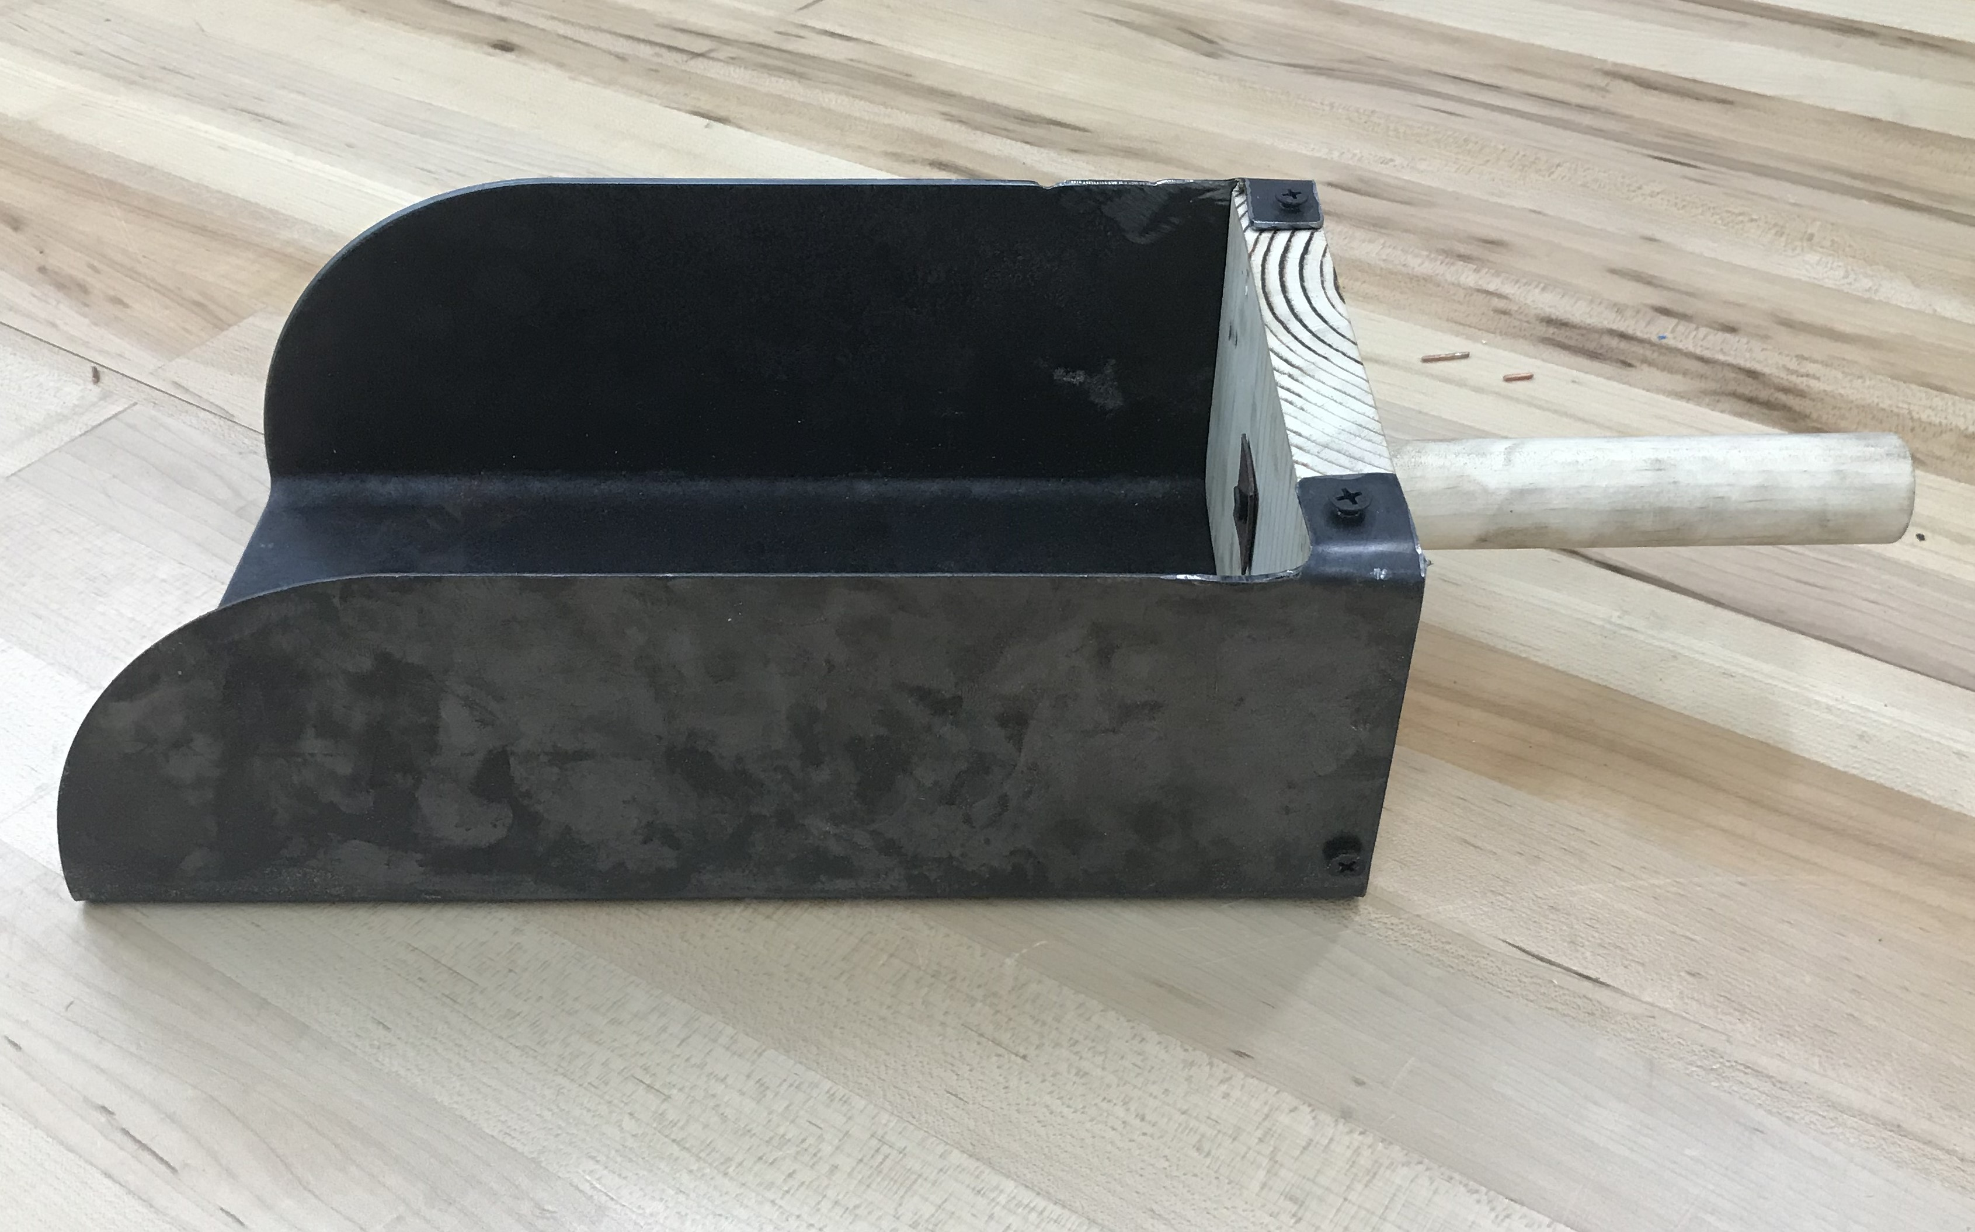
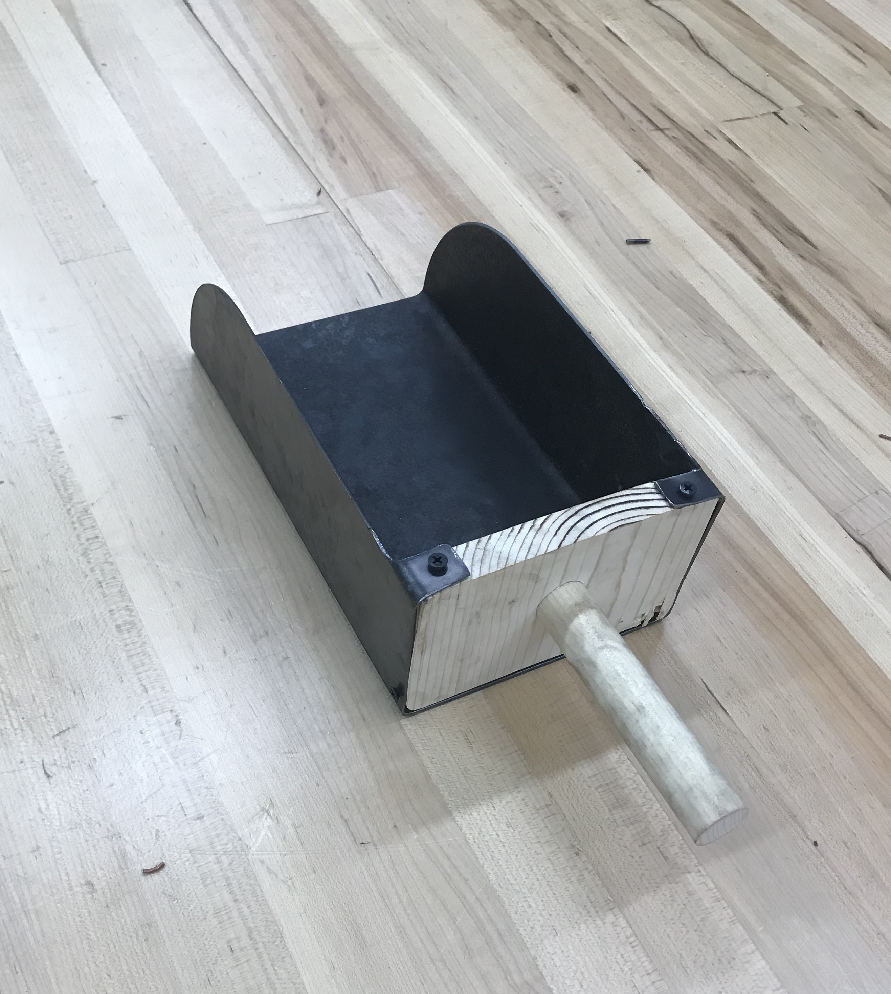
Feed Scoop

Slide 18
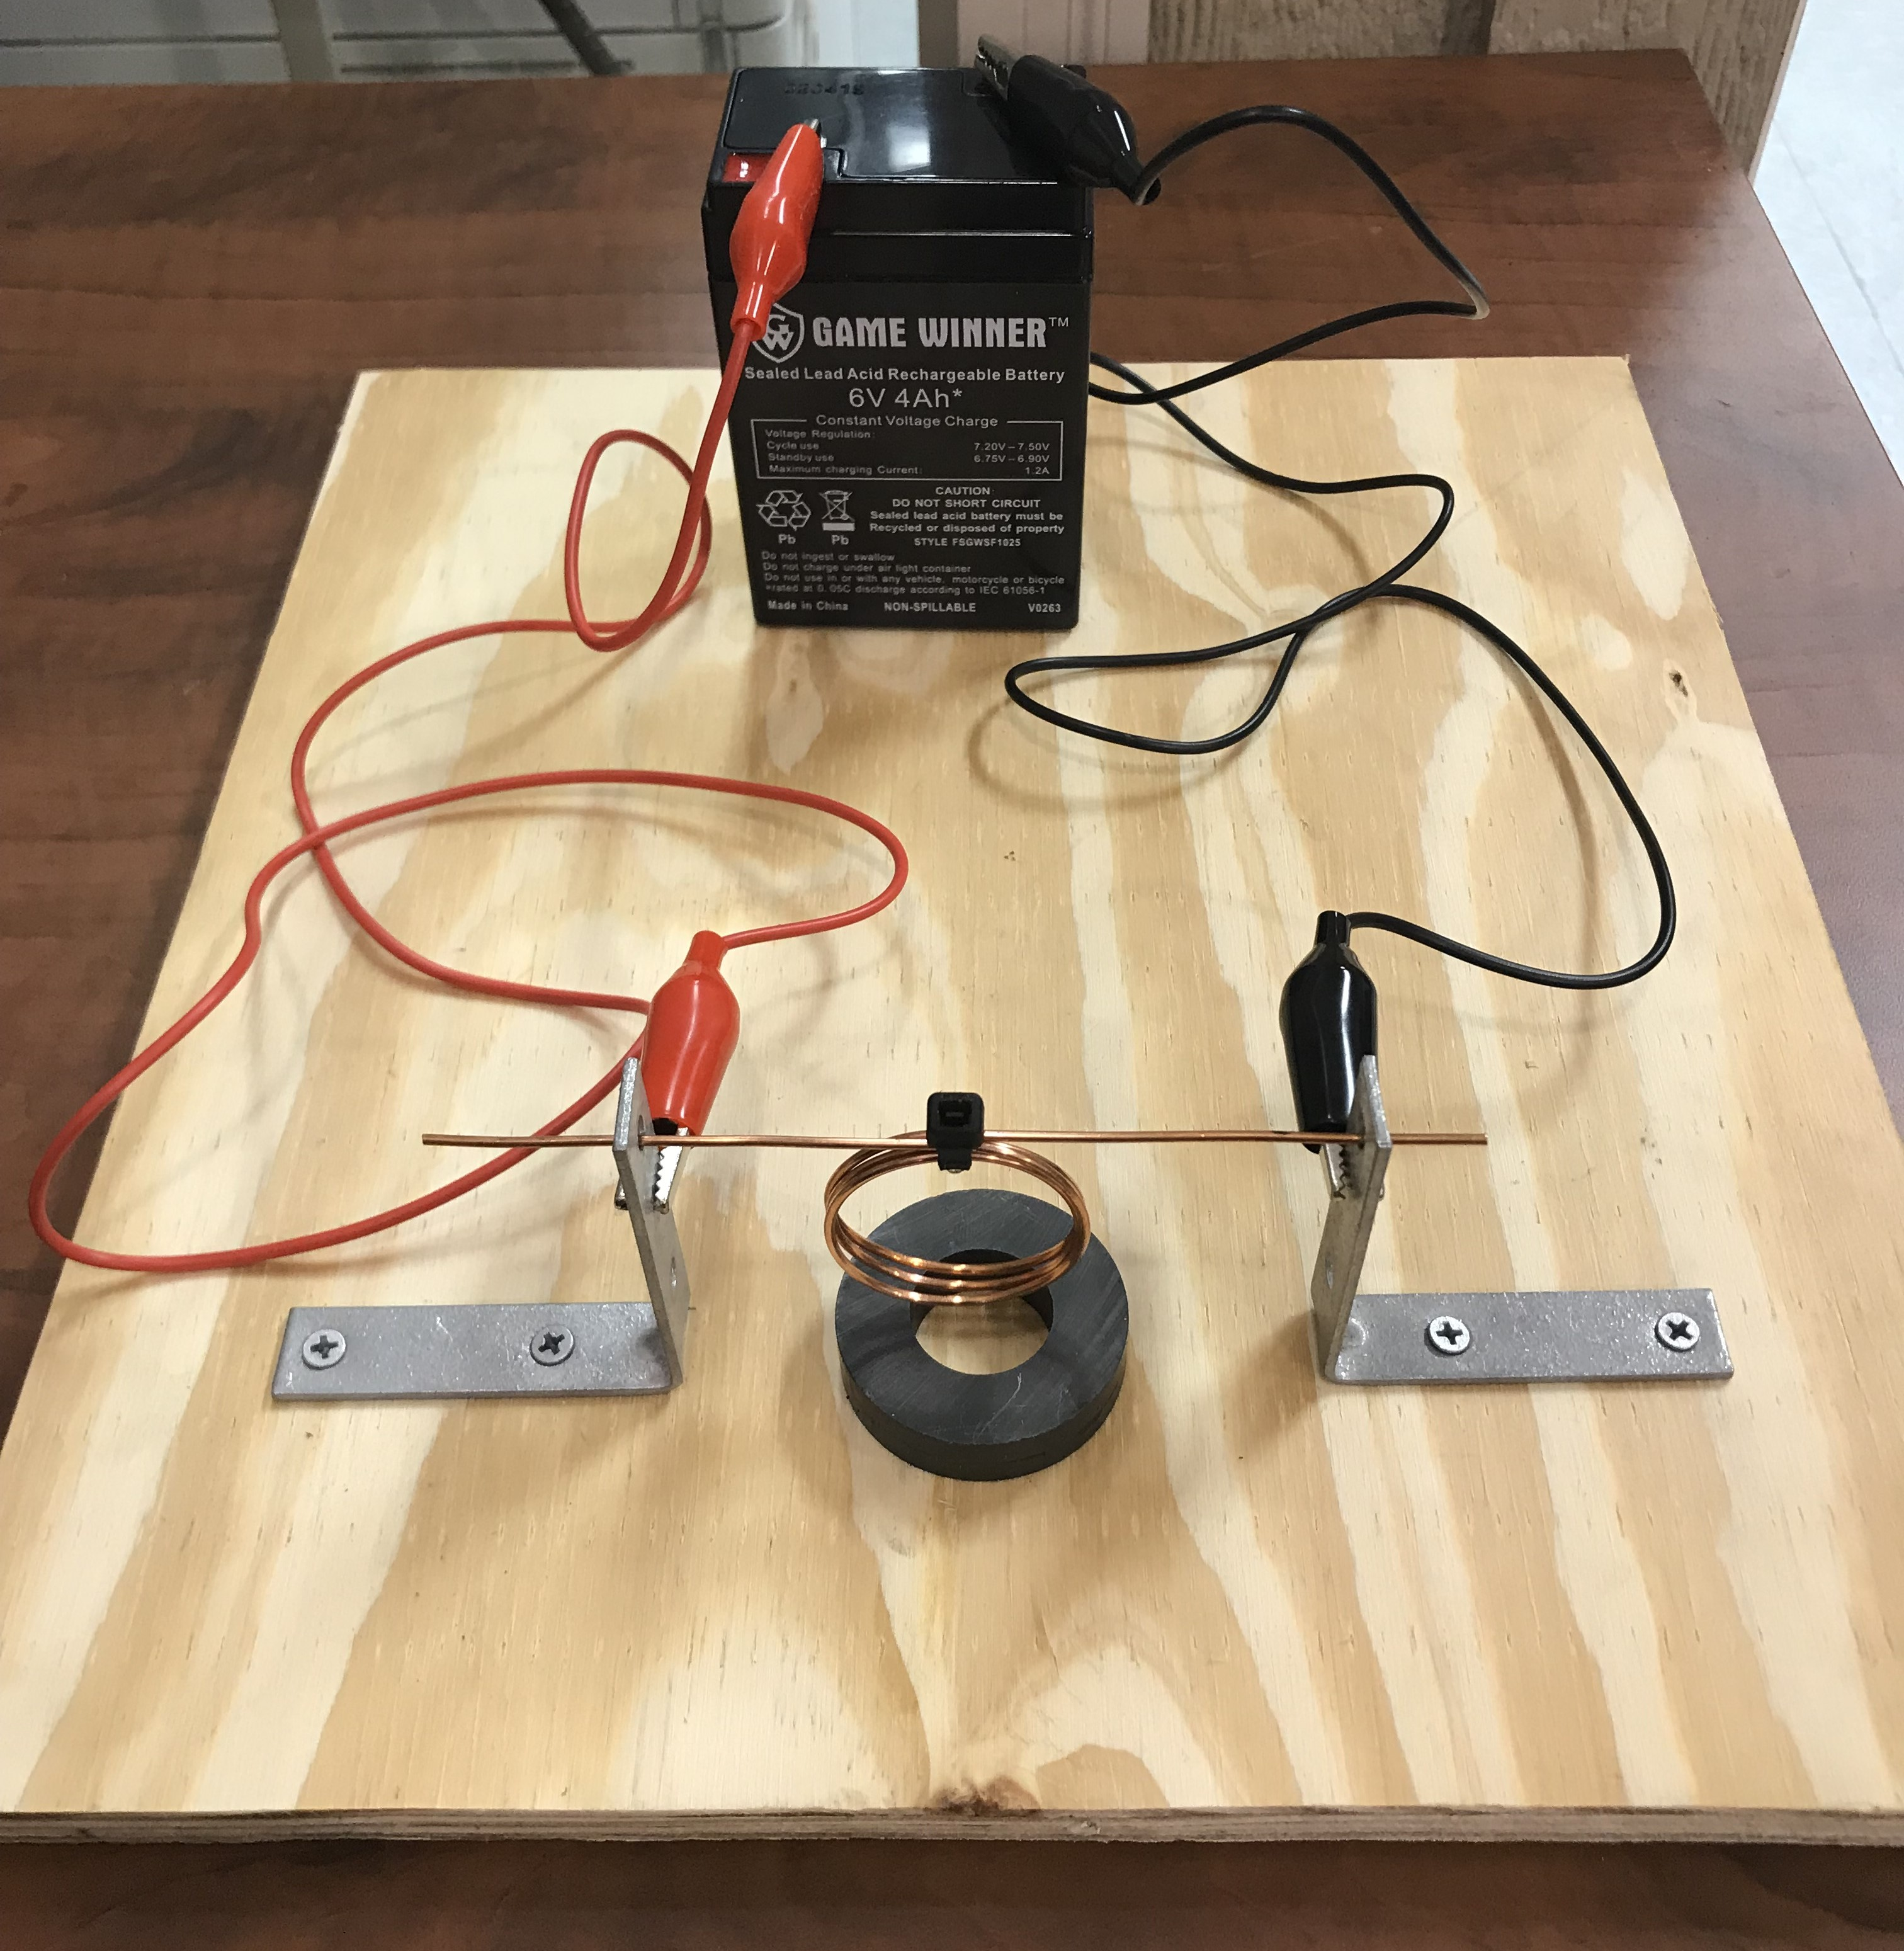
Electric Motor

Slide 19
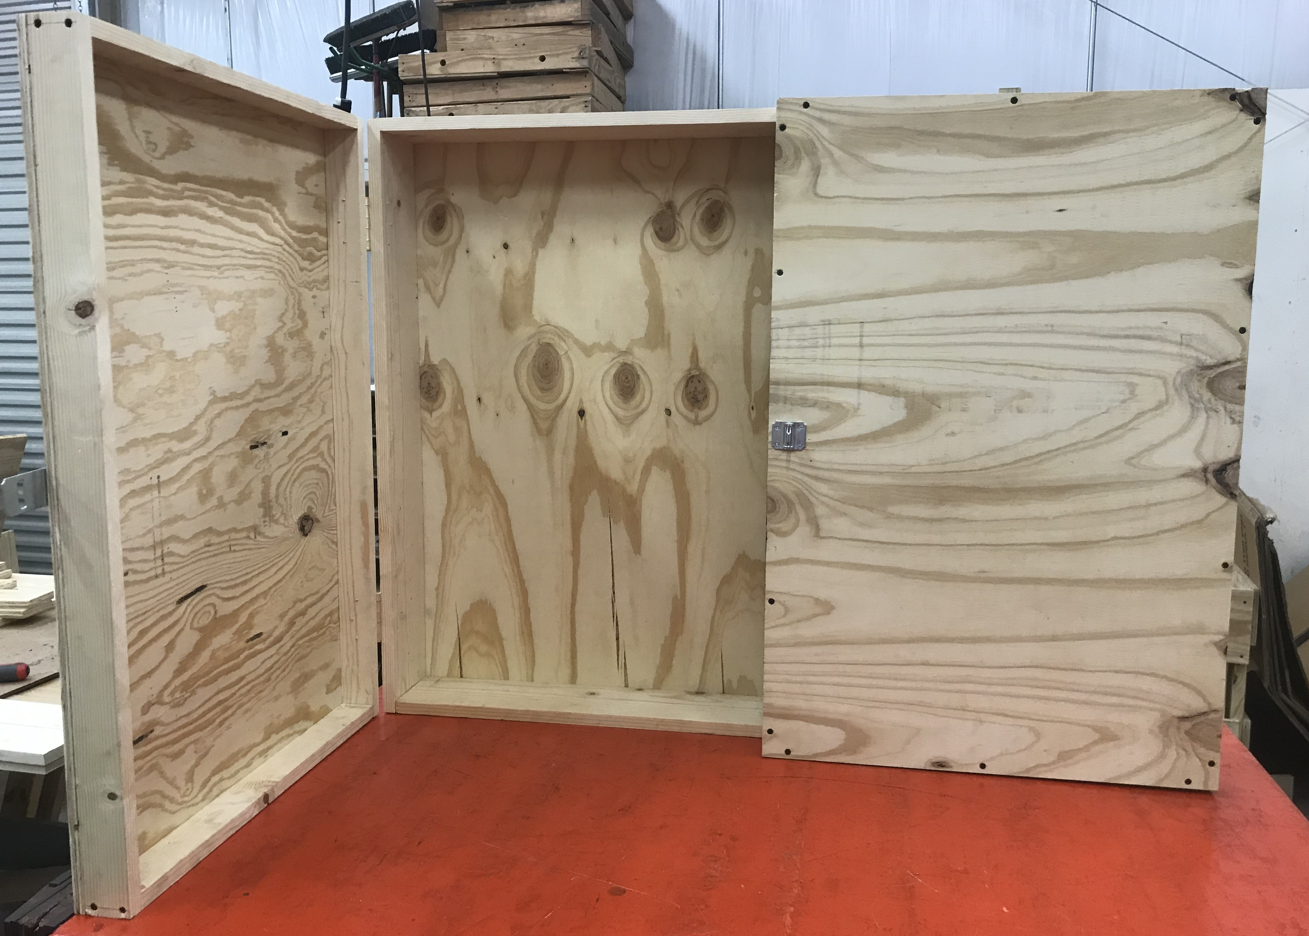
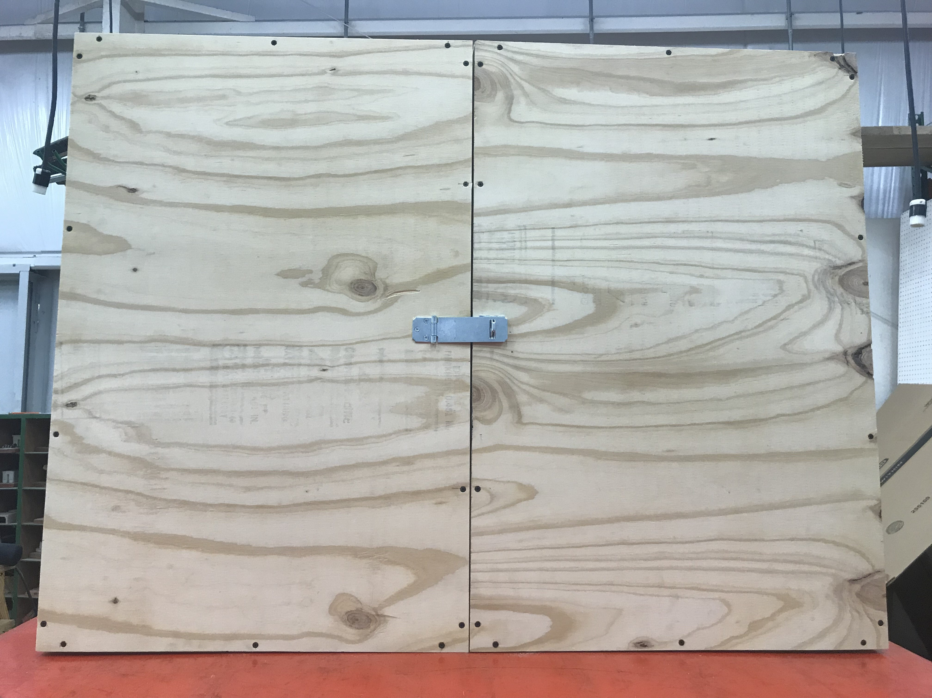
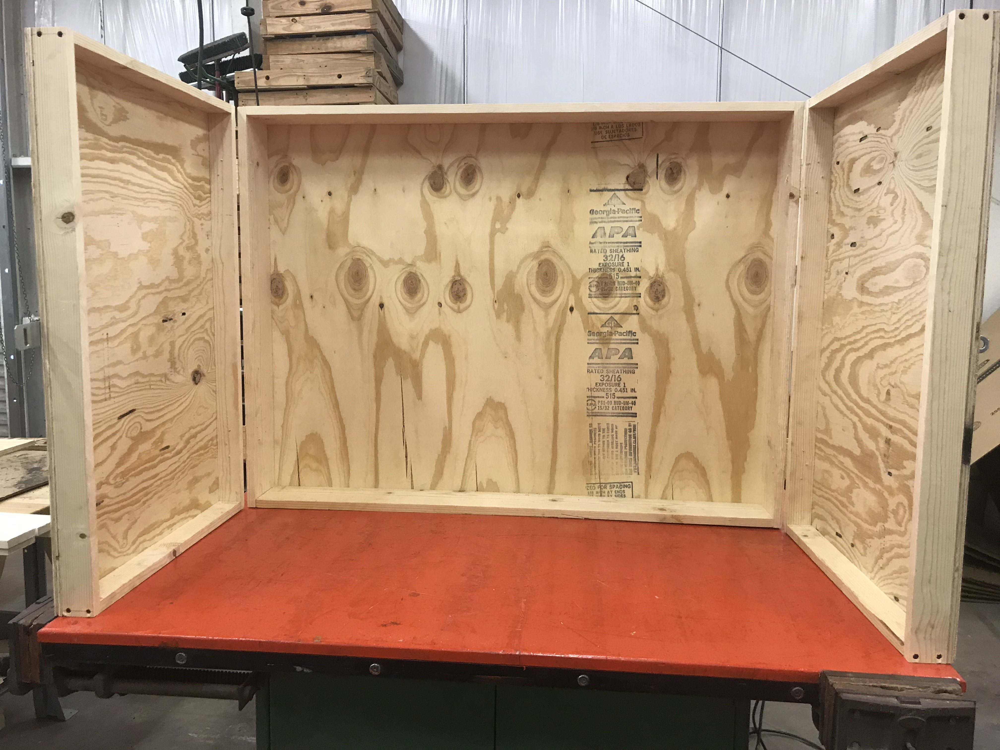
Tool Cabinet

Slide 20
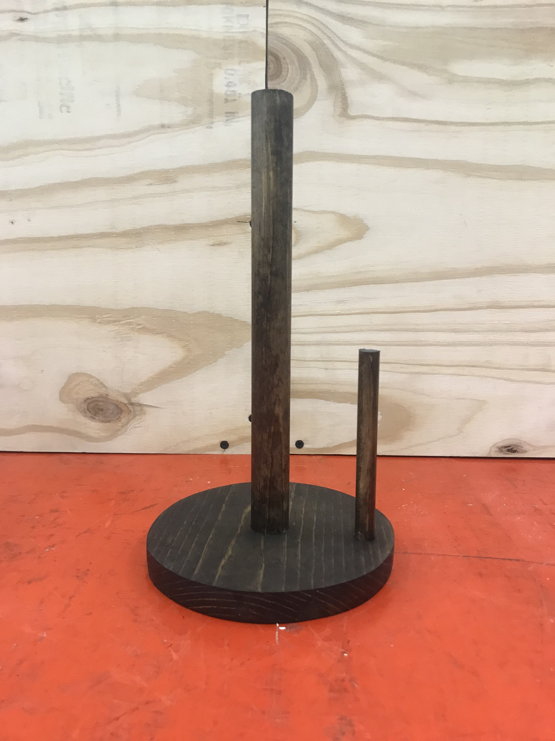
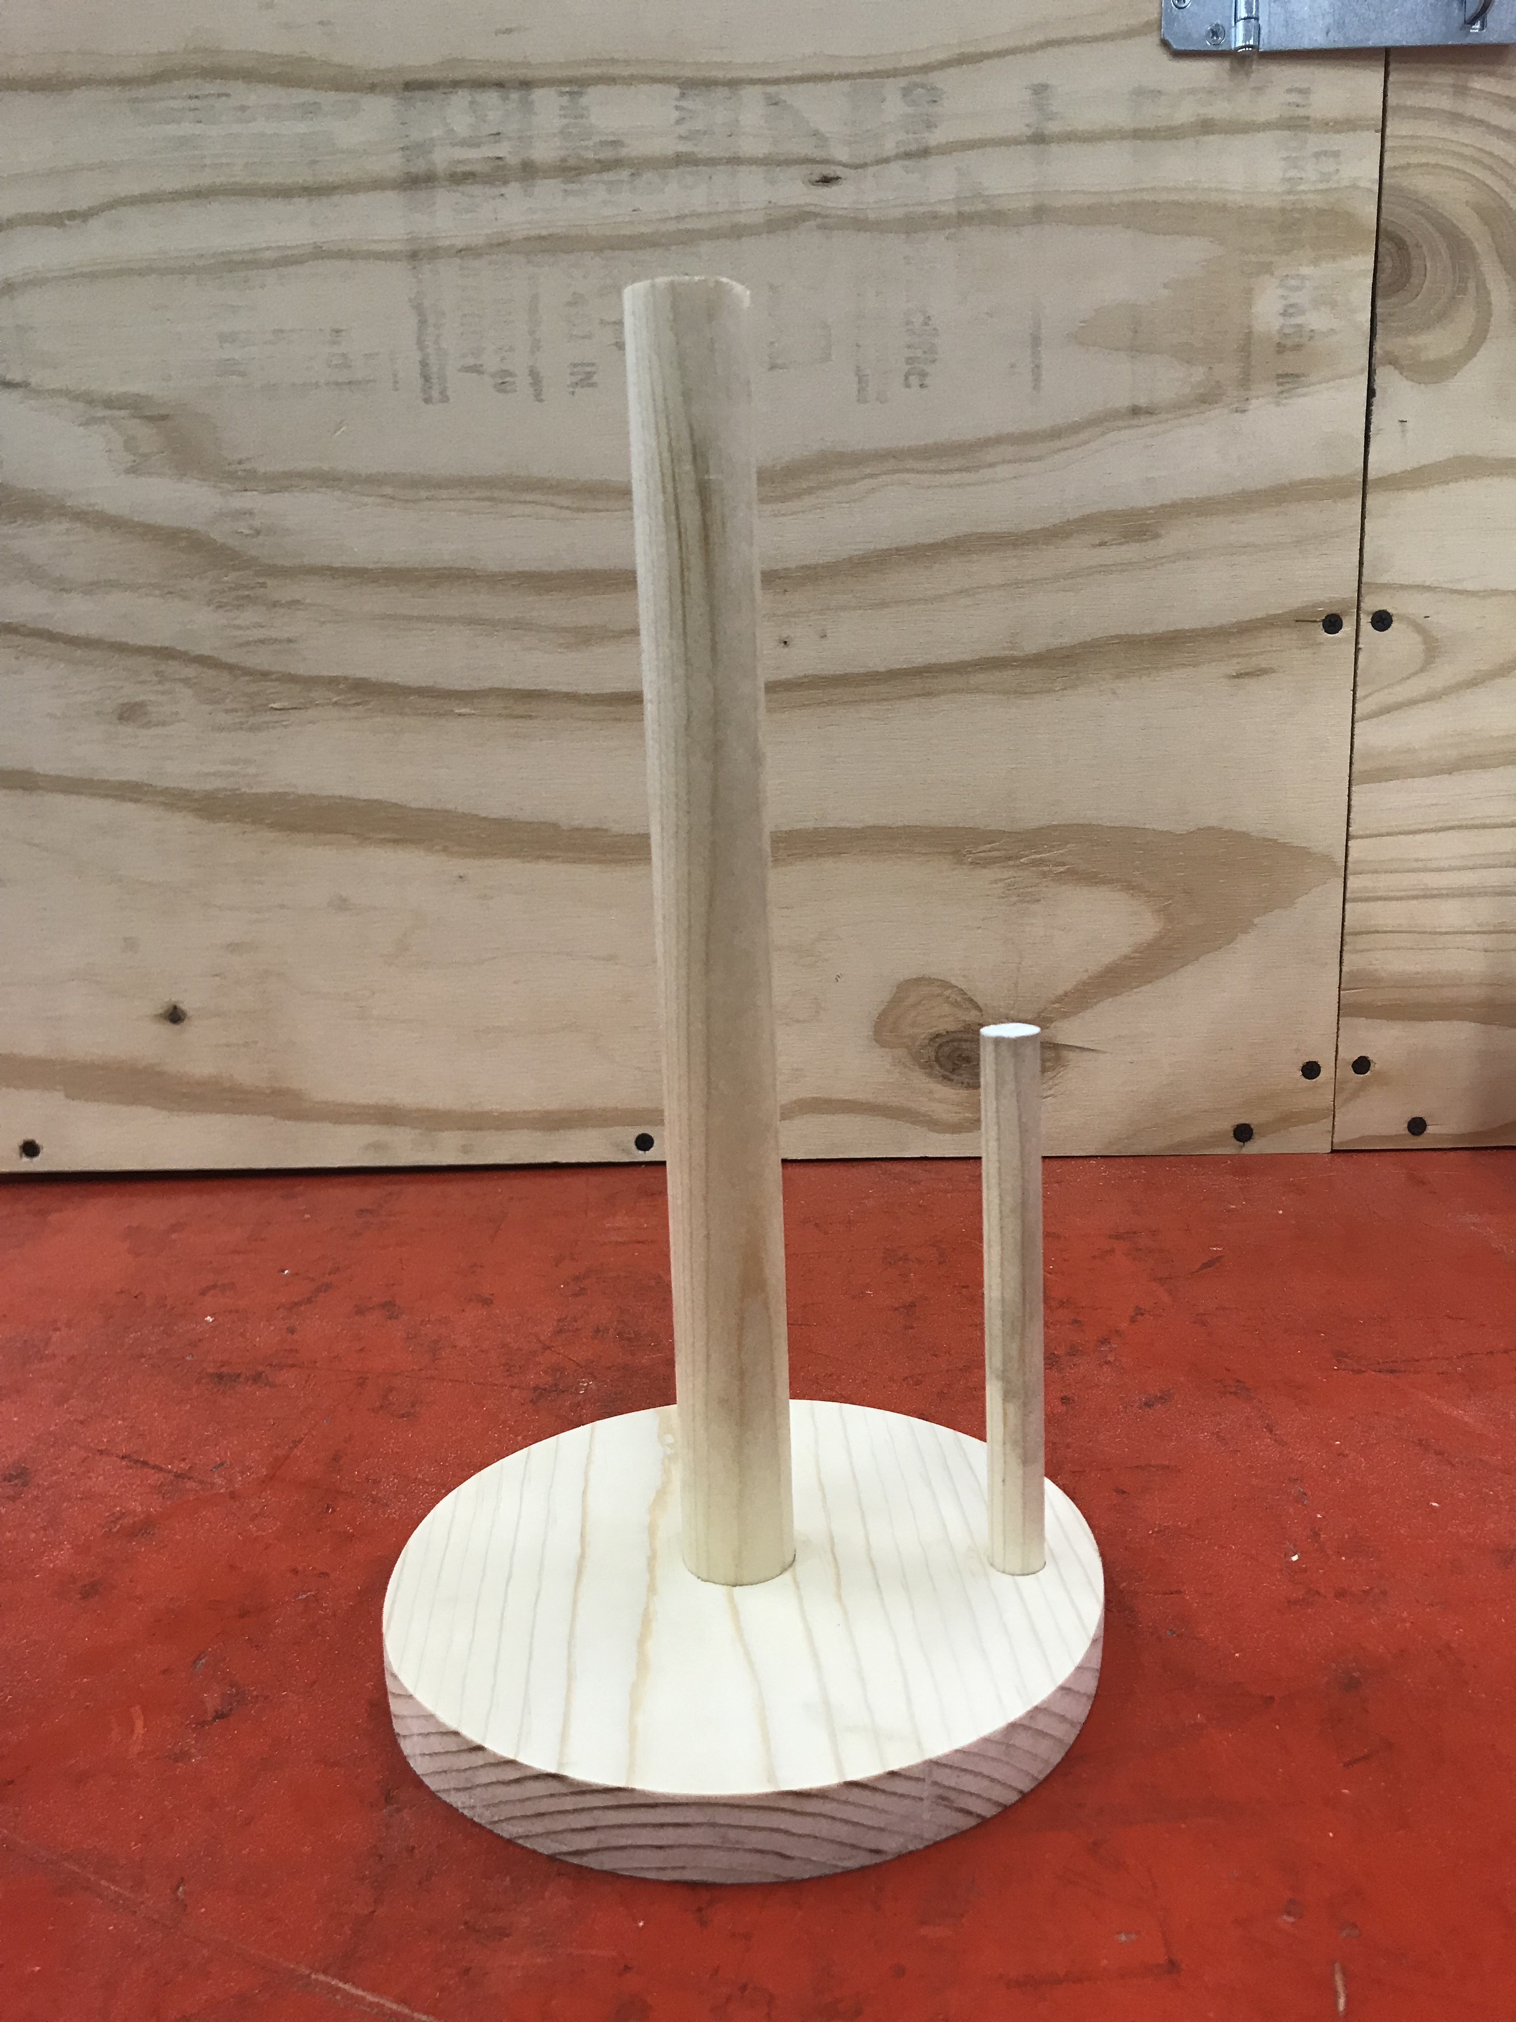
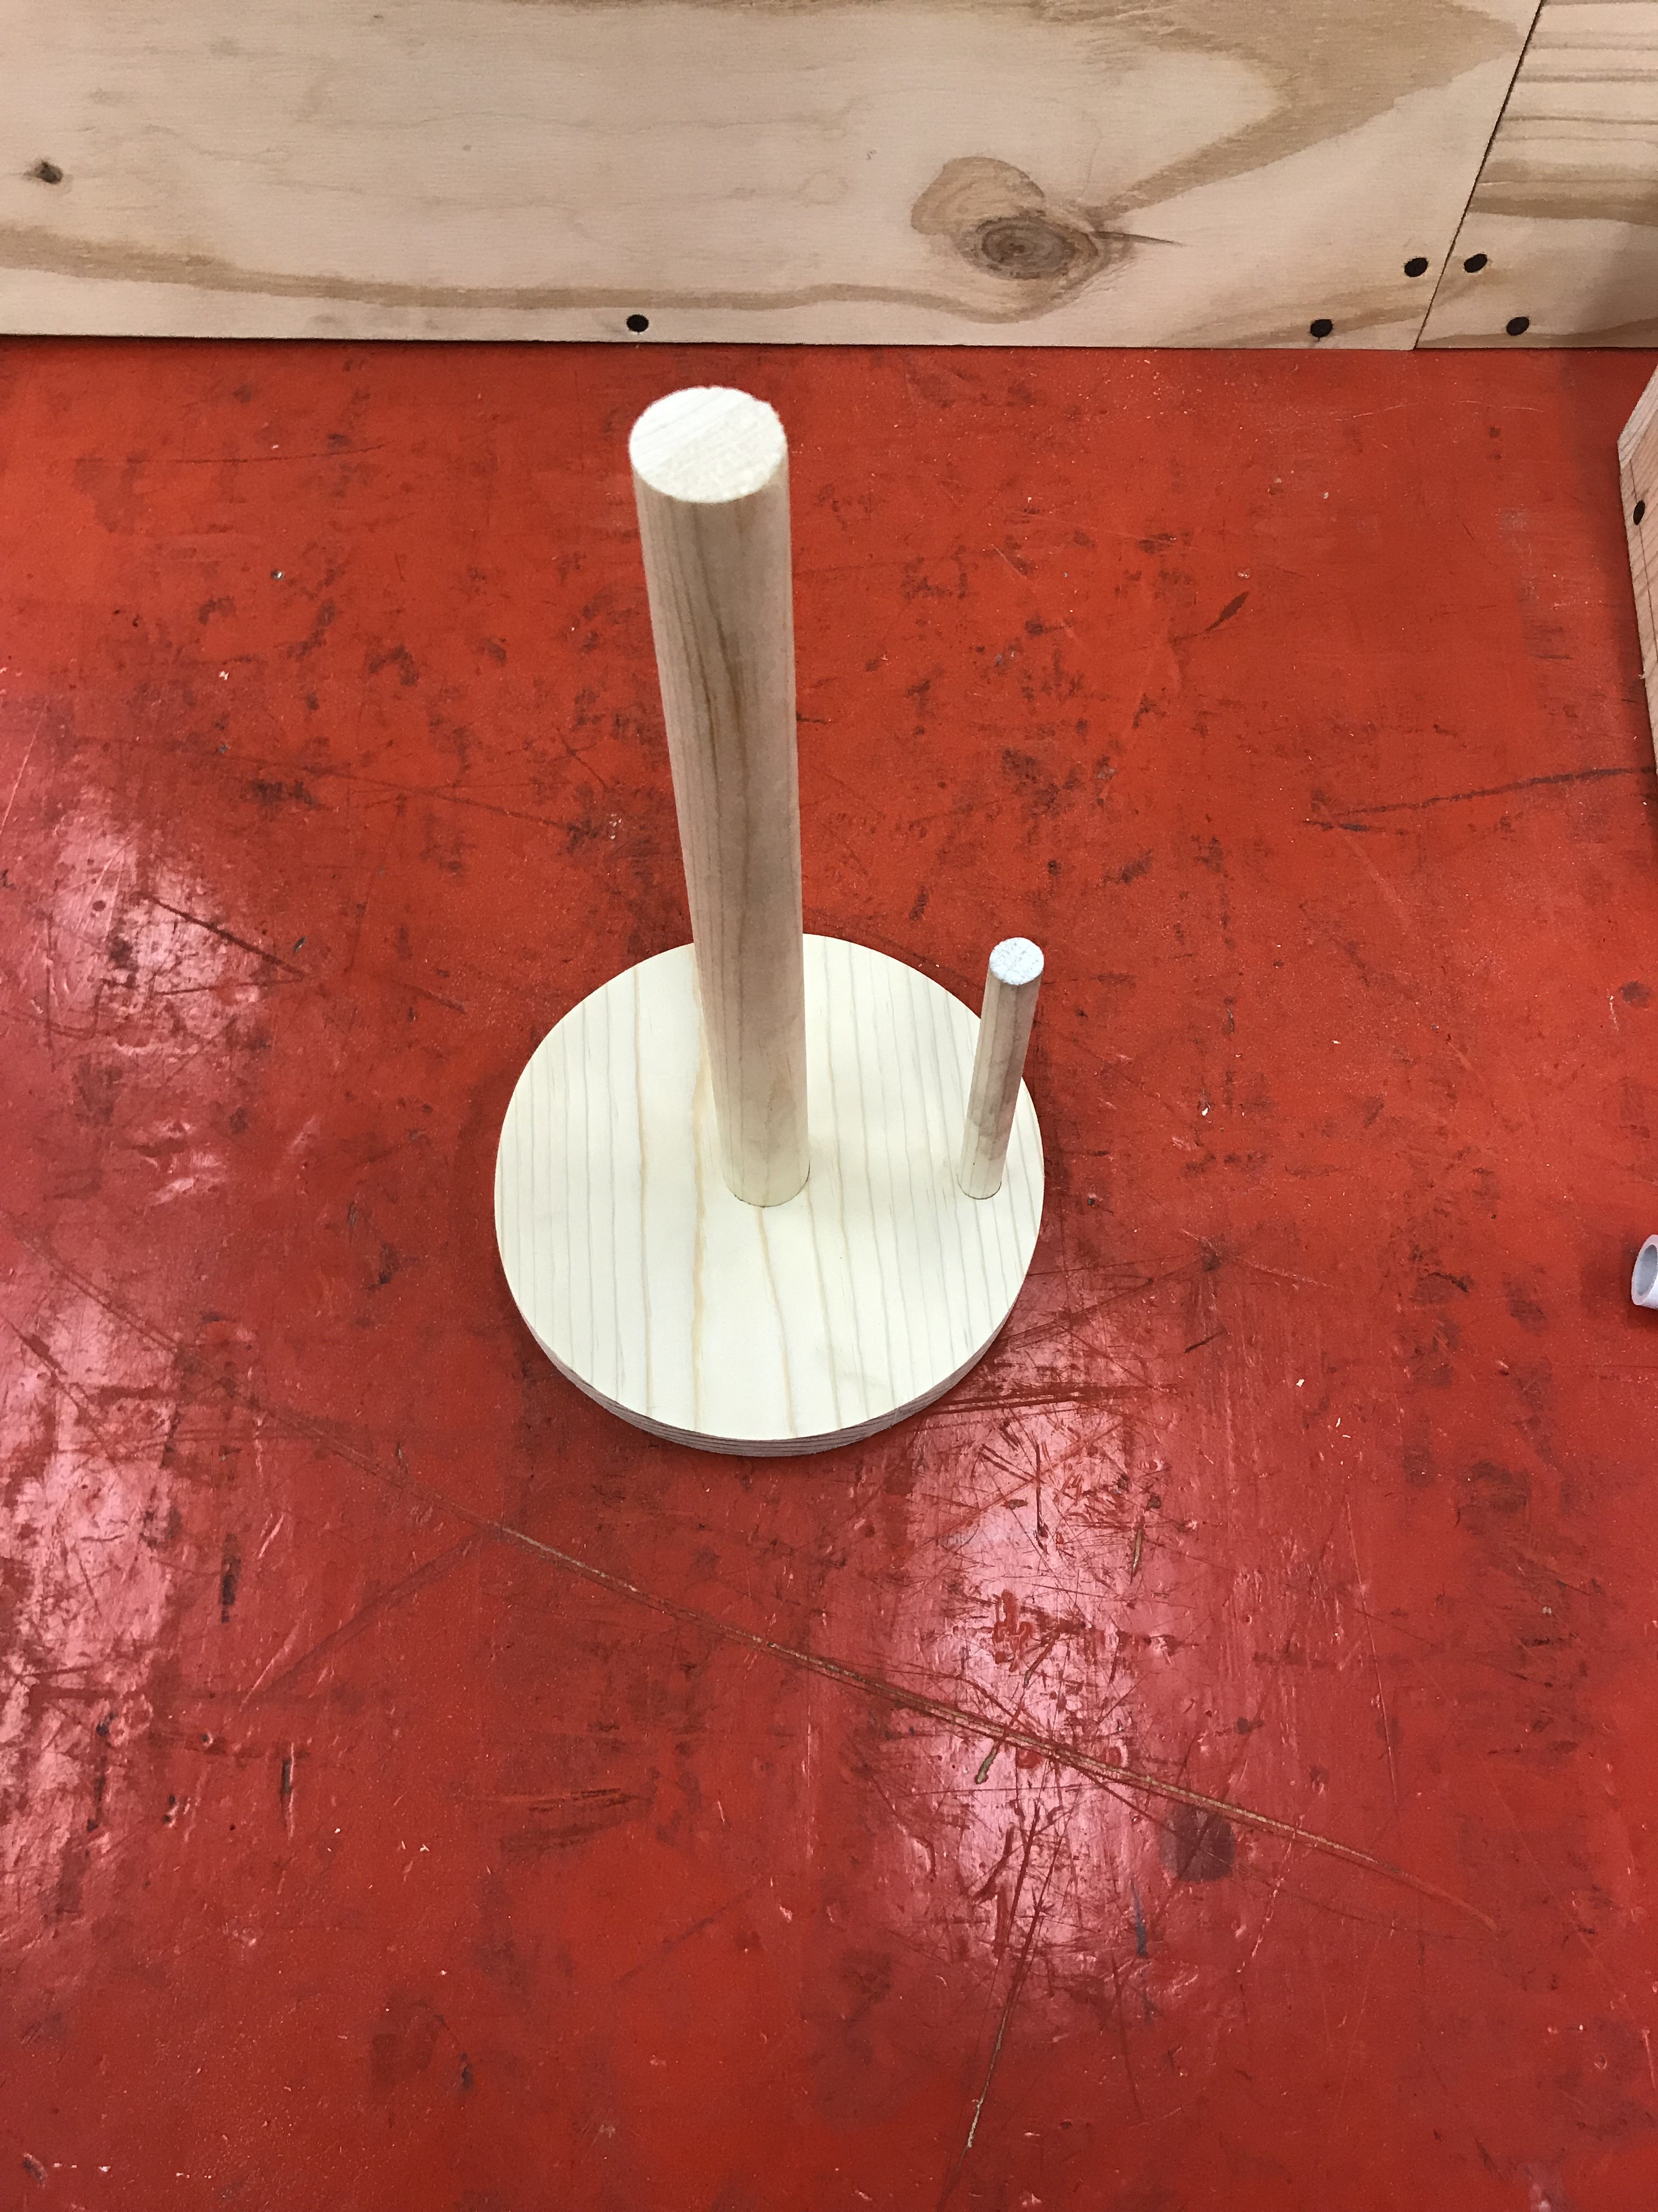
Paper Towel Holder

Slide 21
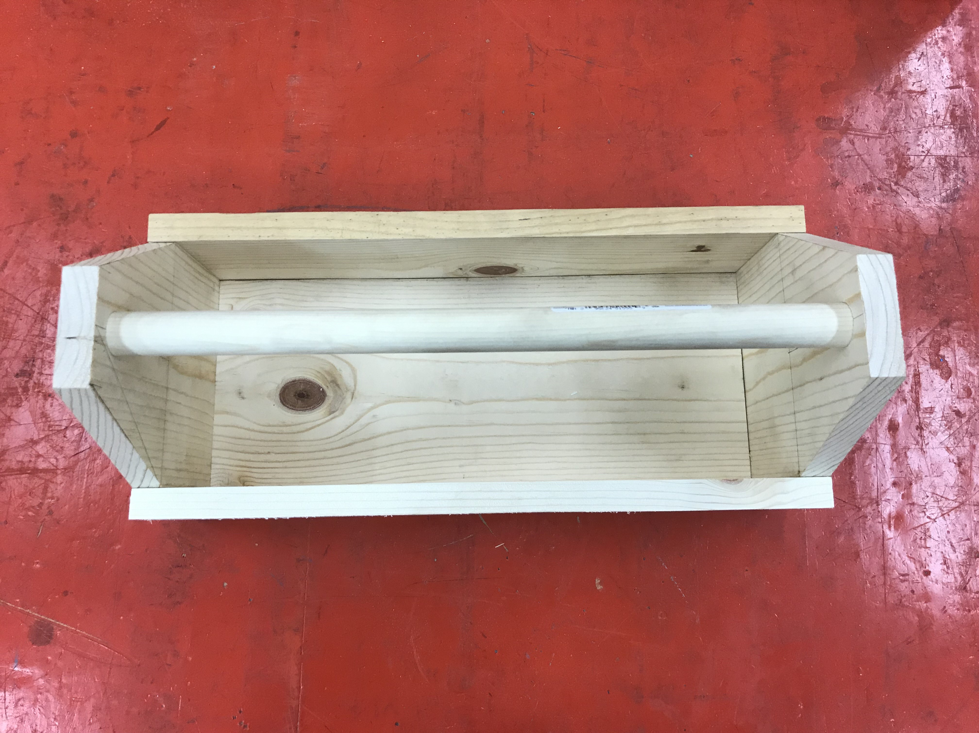
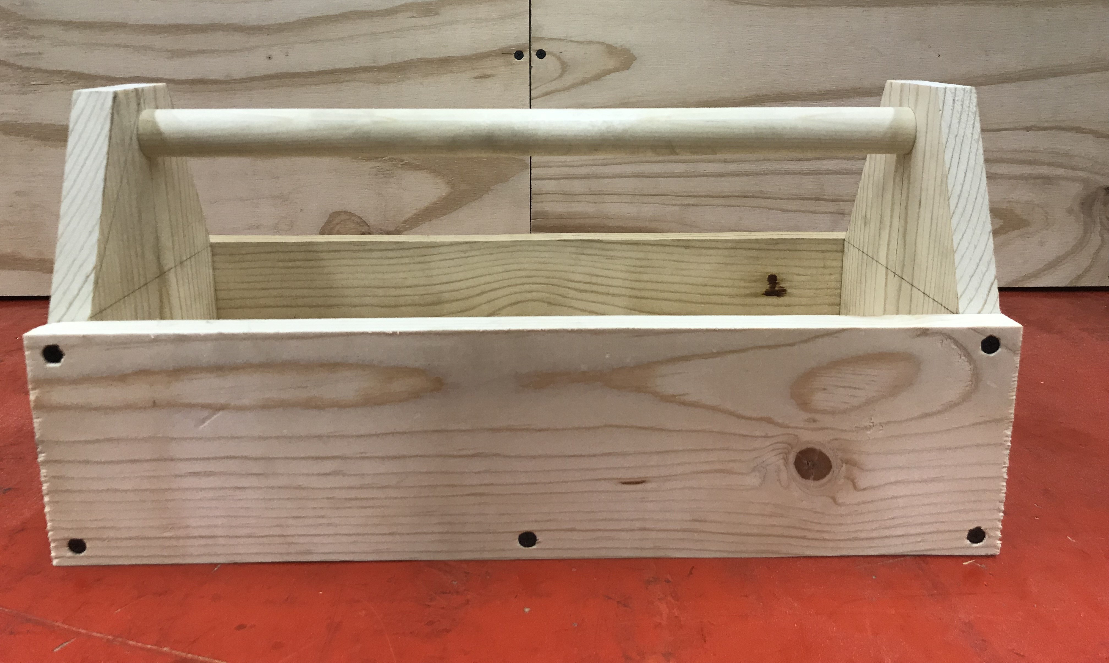
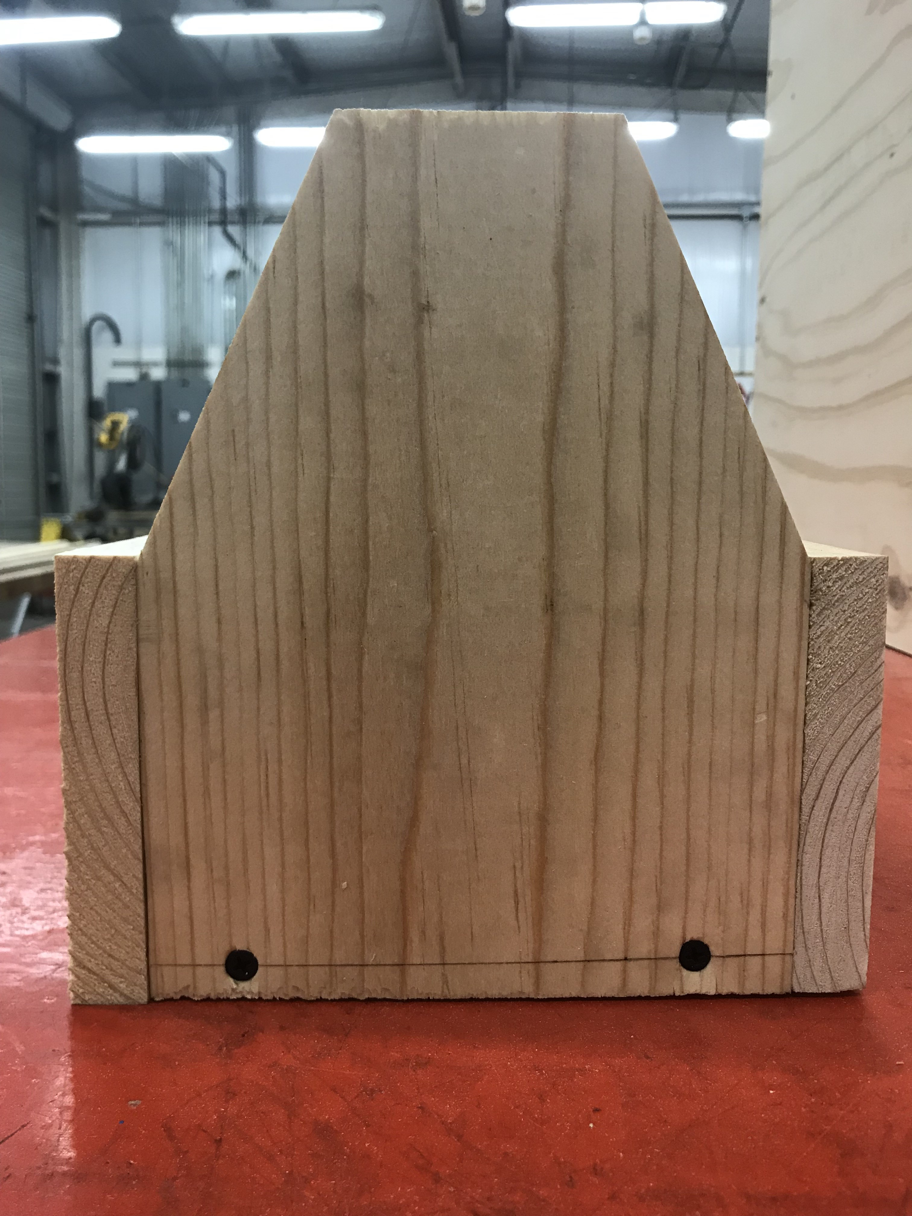
Tool Box

Slide 22
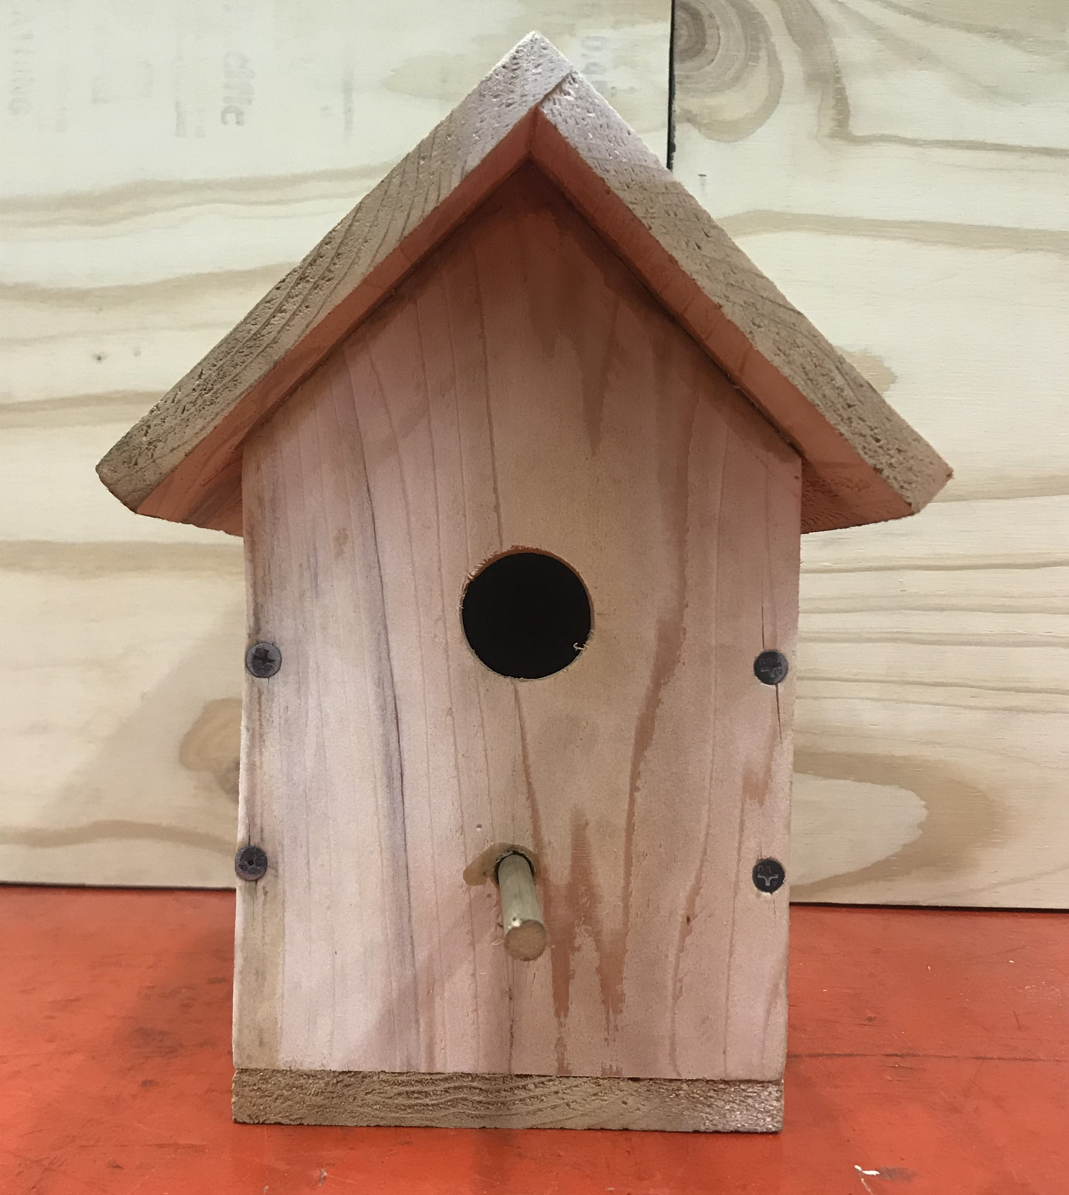
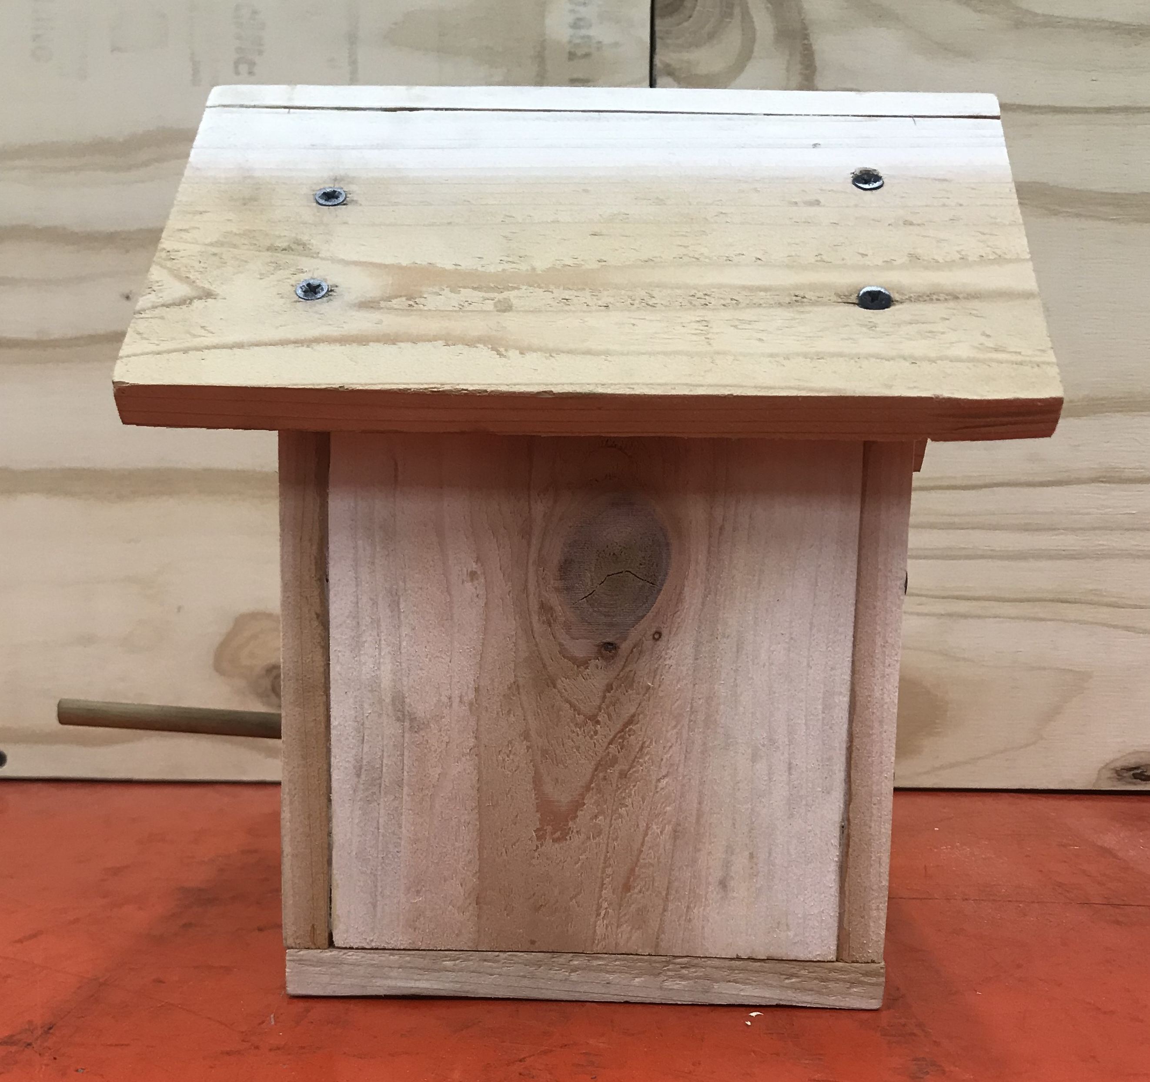
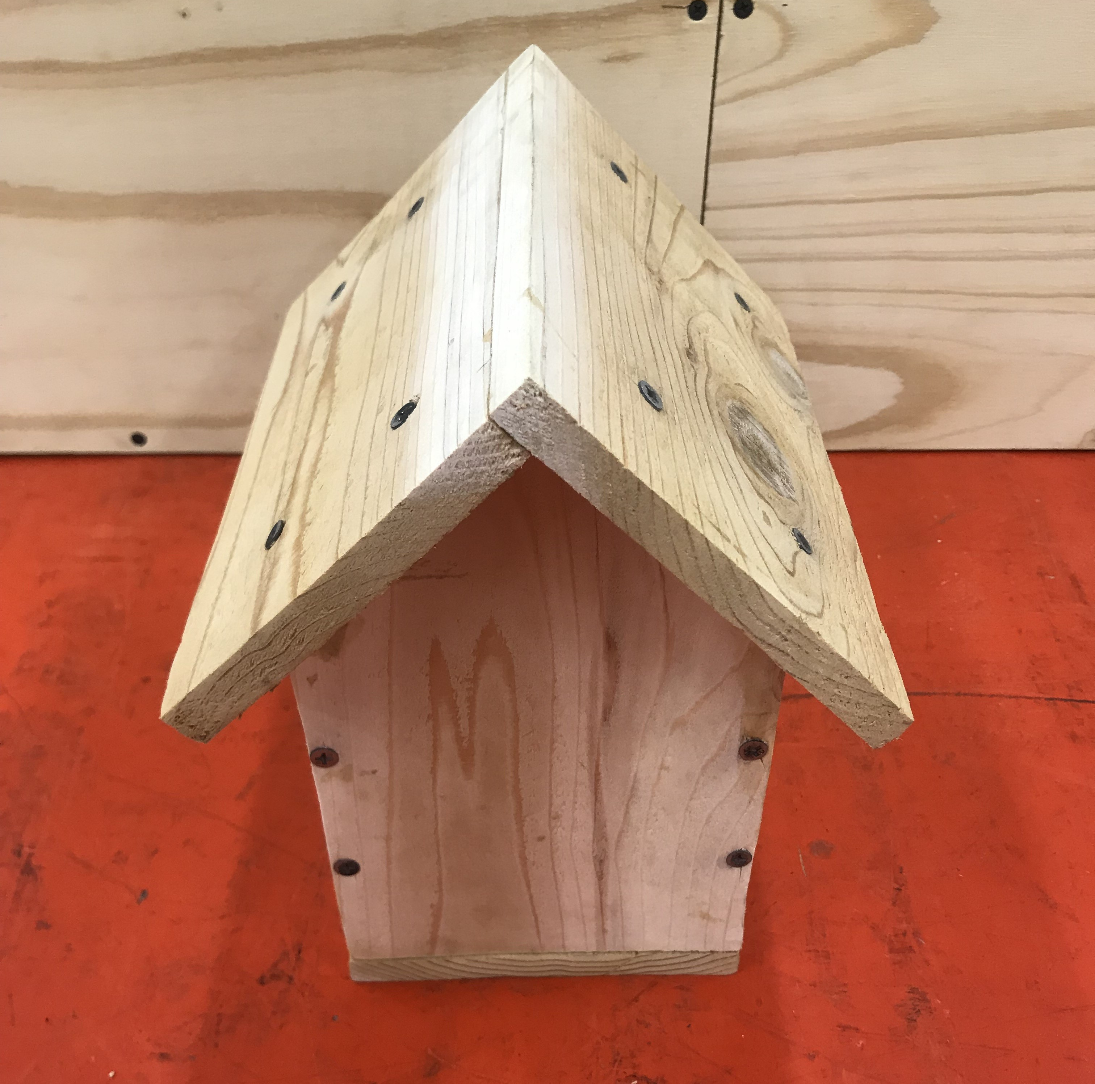
Birdhouse

Slide 23

Q & A
Any Questions?

