Slide 1
Birdville ISD Megan Brundrett & Tyler McCoy
Restarted in 2018
2018- 86 Students
2021/22- 356 Students
Student Enterprise Model
Program/Participation Promotion
Students
First 2 weeks
Parent Meetings
”Get Lists”
Branding
SAE Recordbooks
Project Planning to Comps

Slide 2
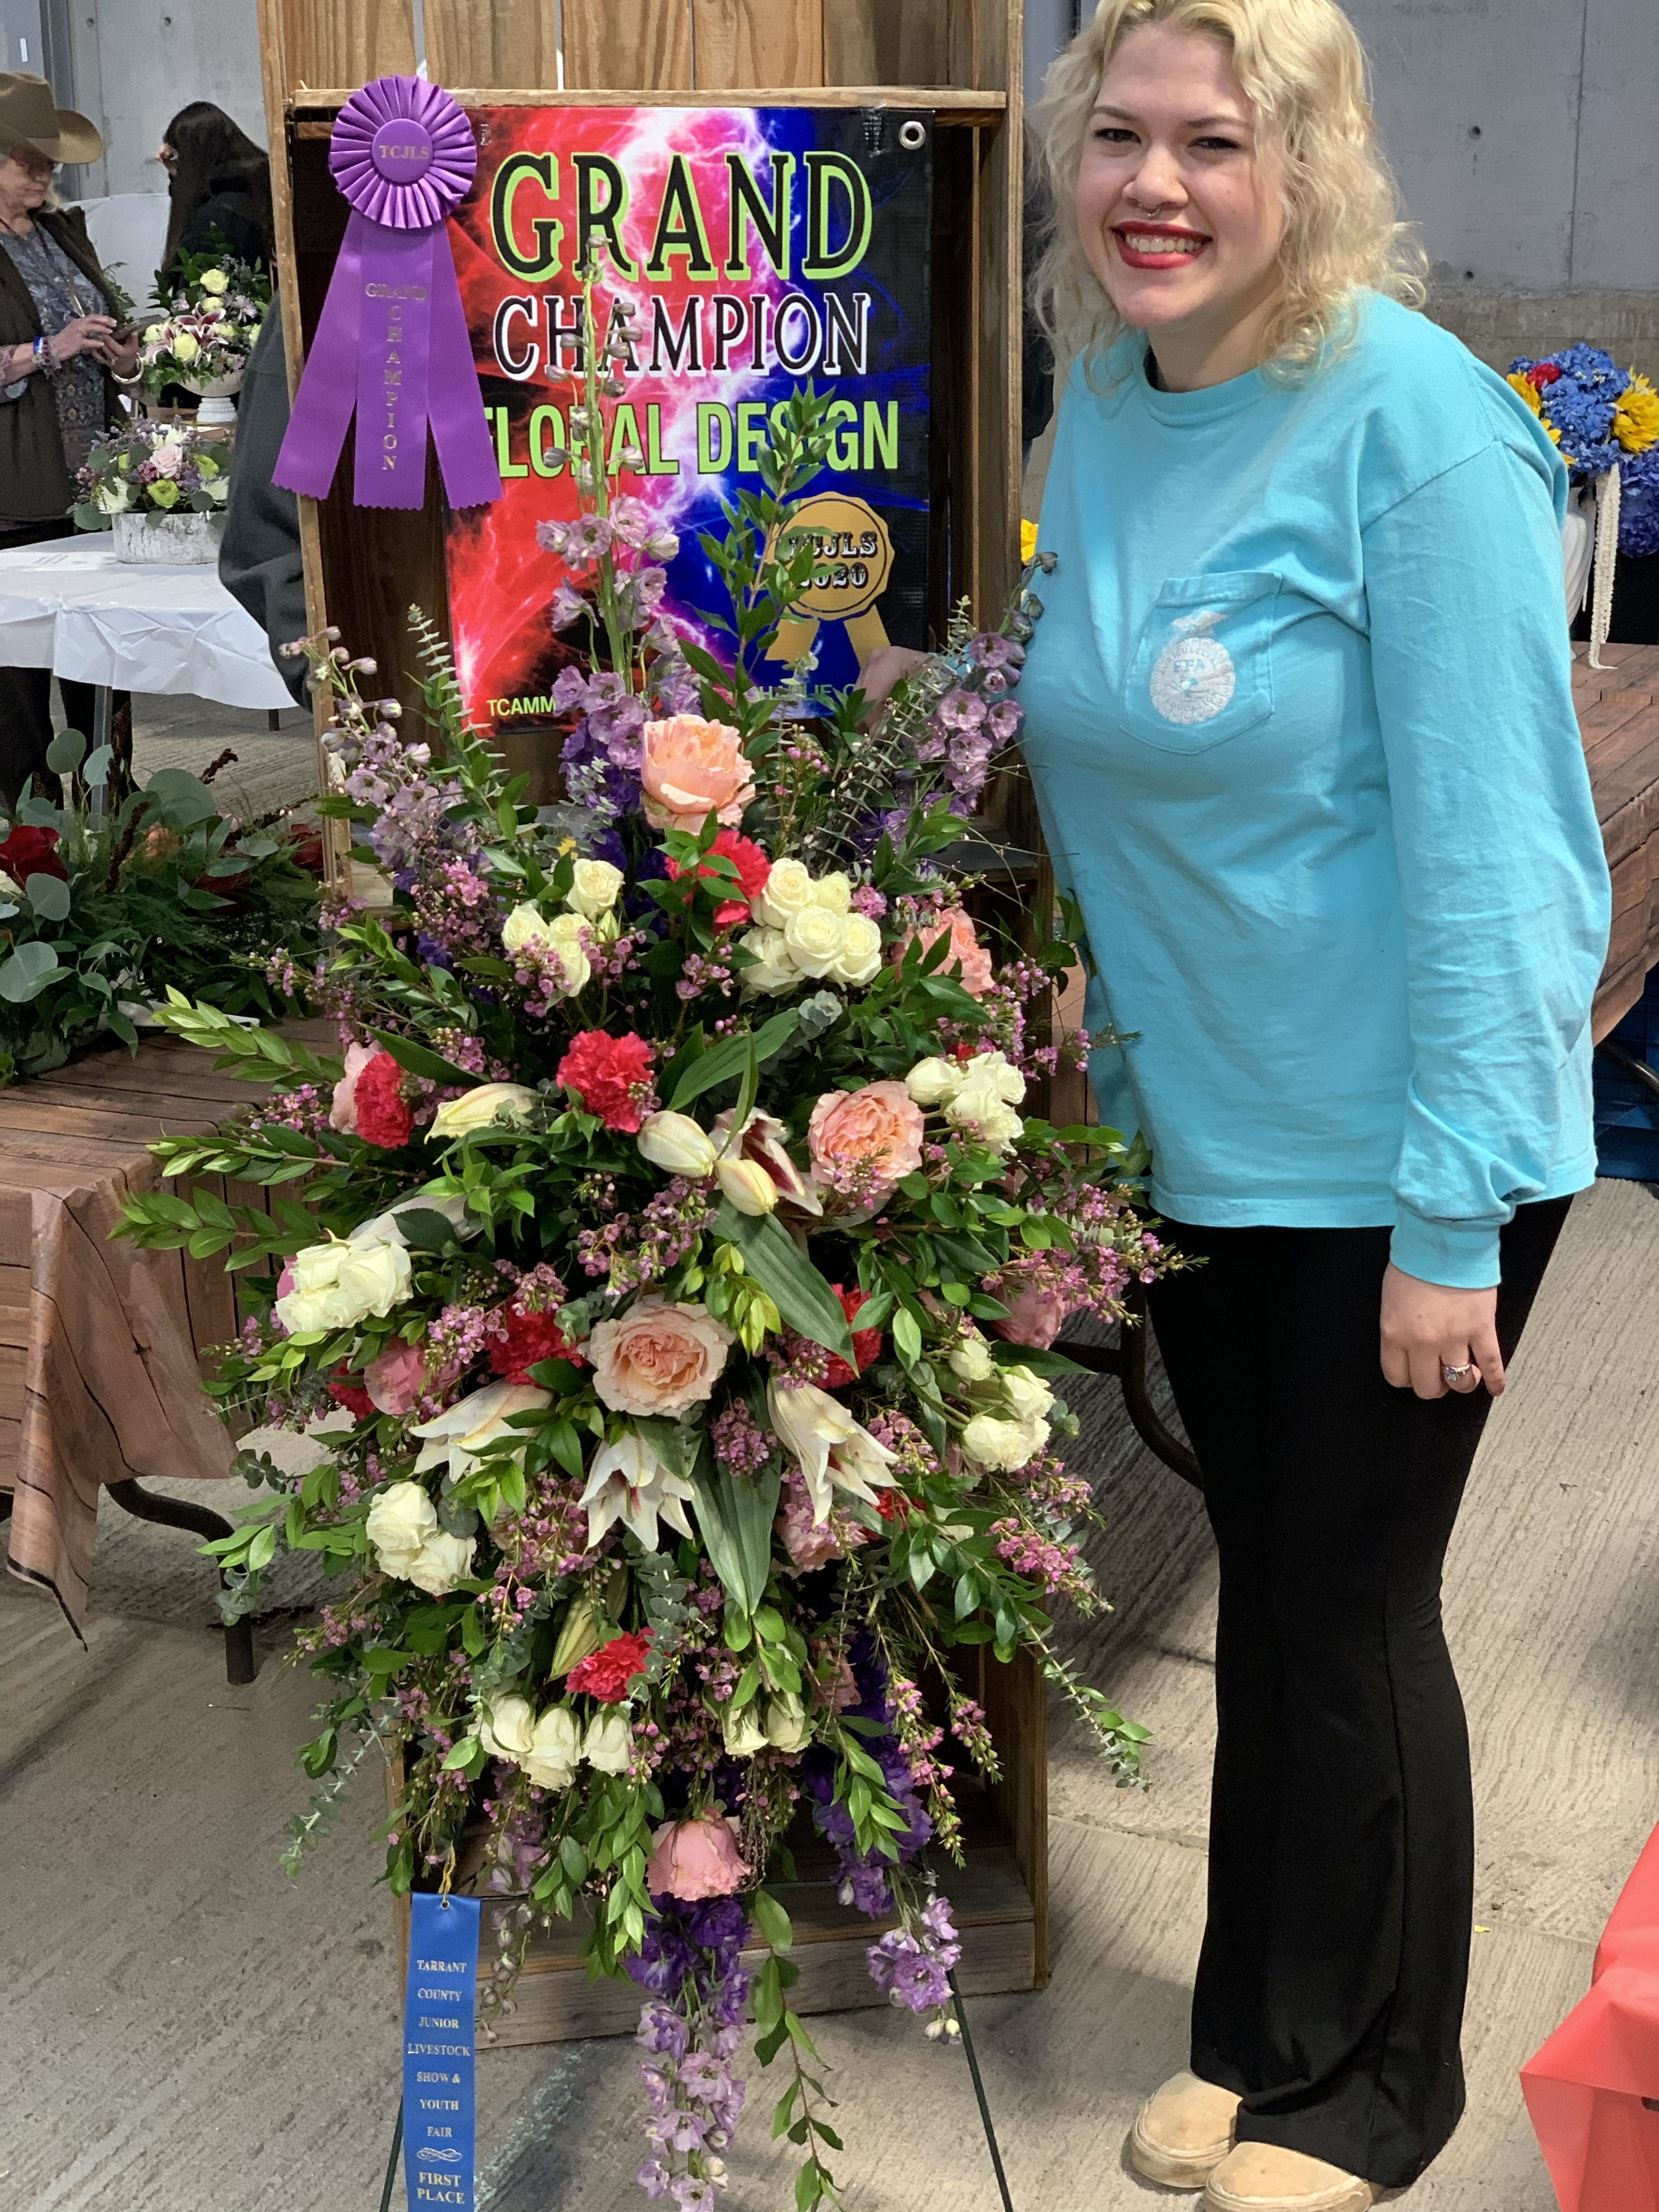
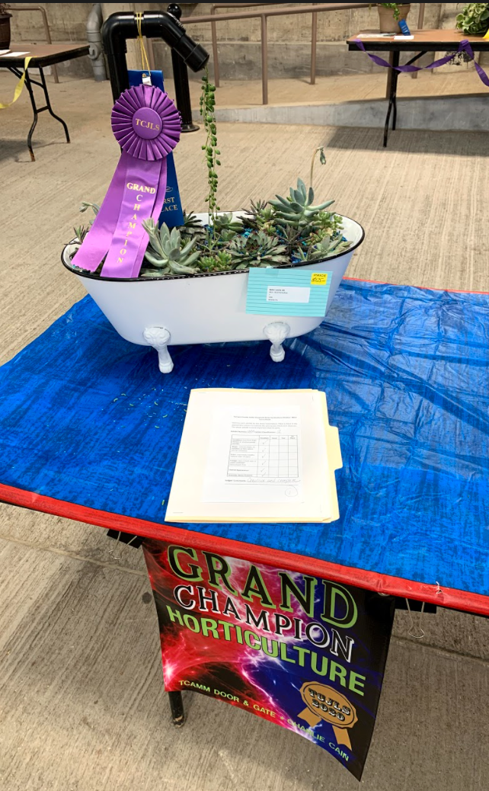
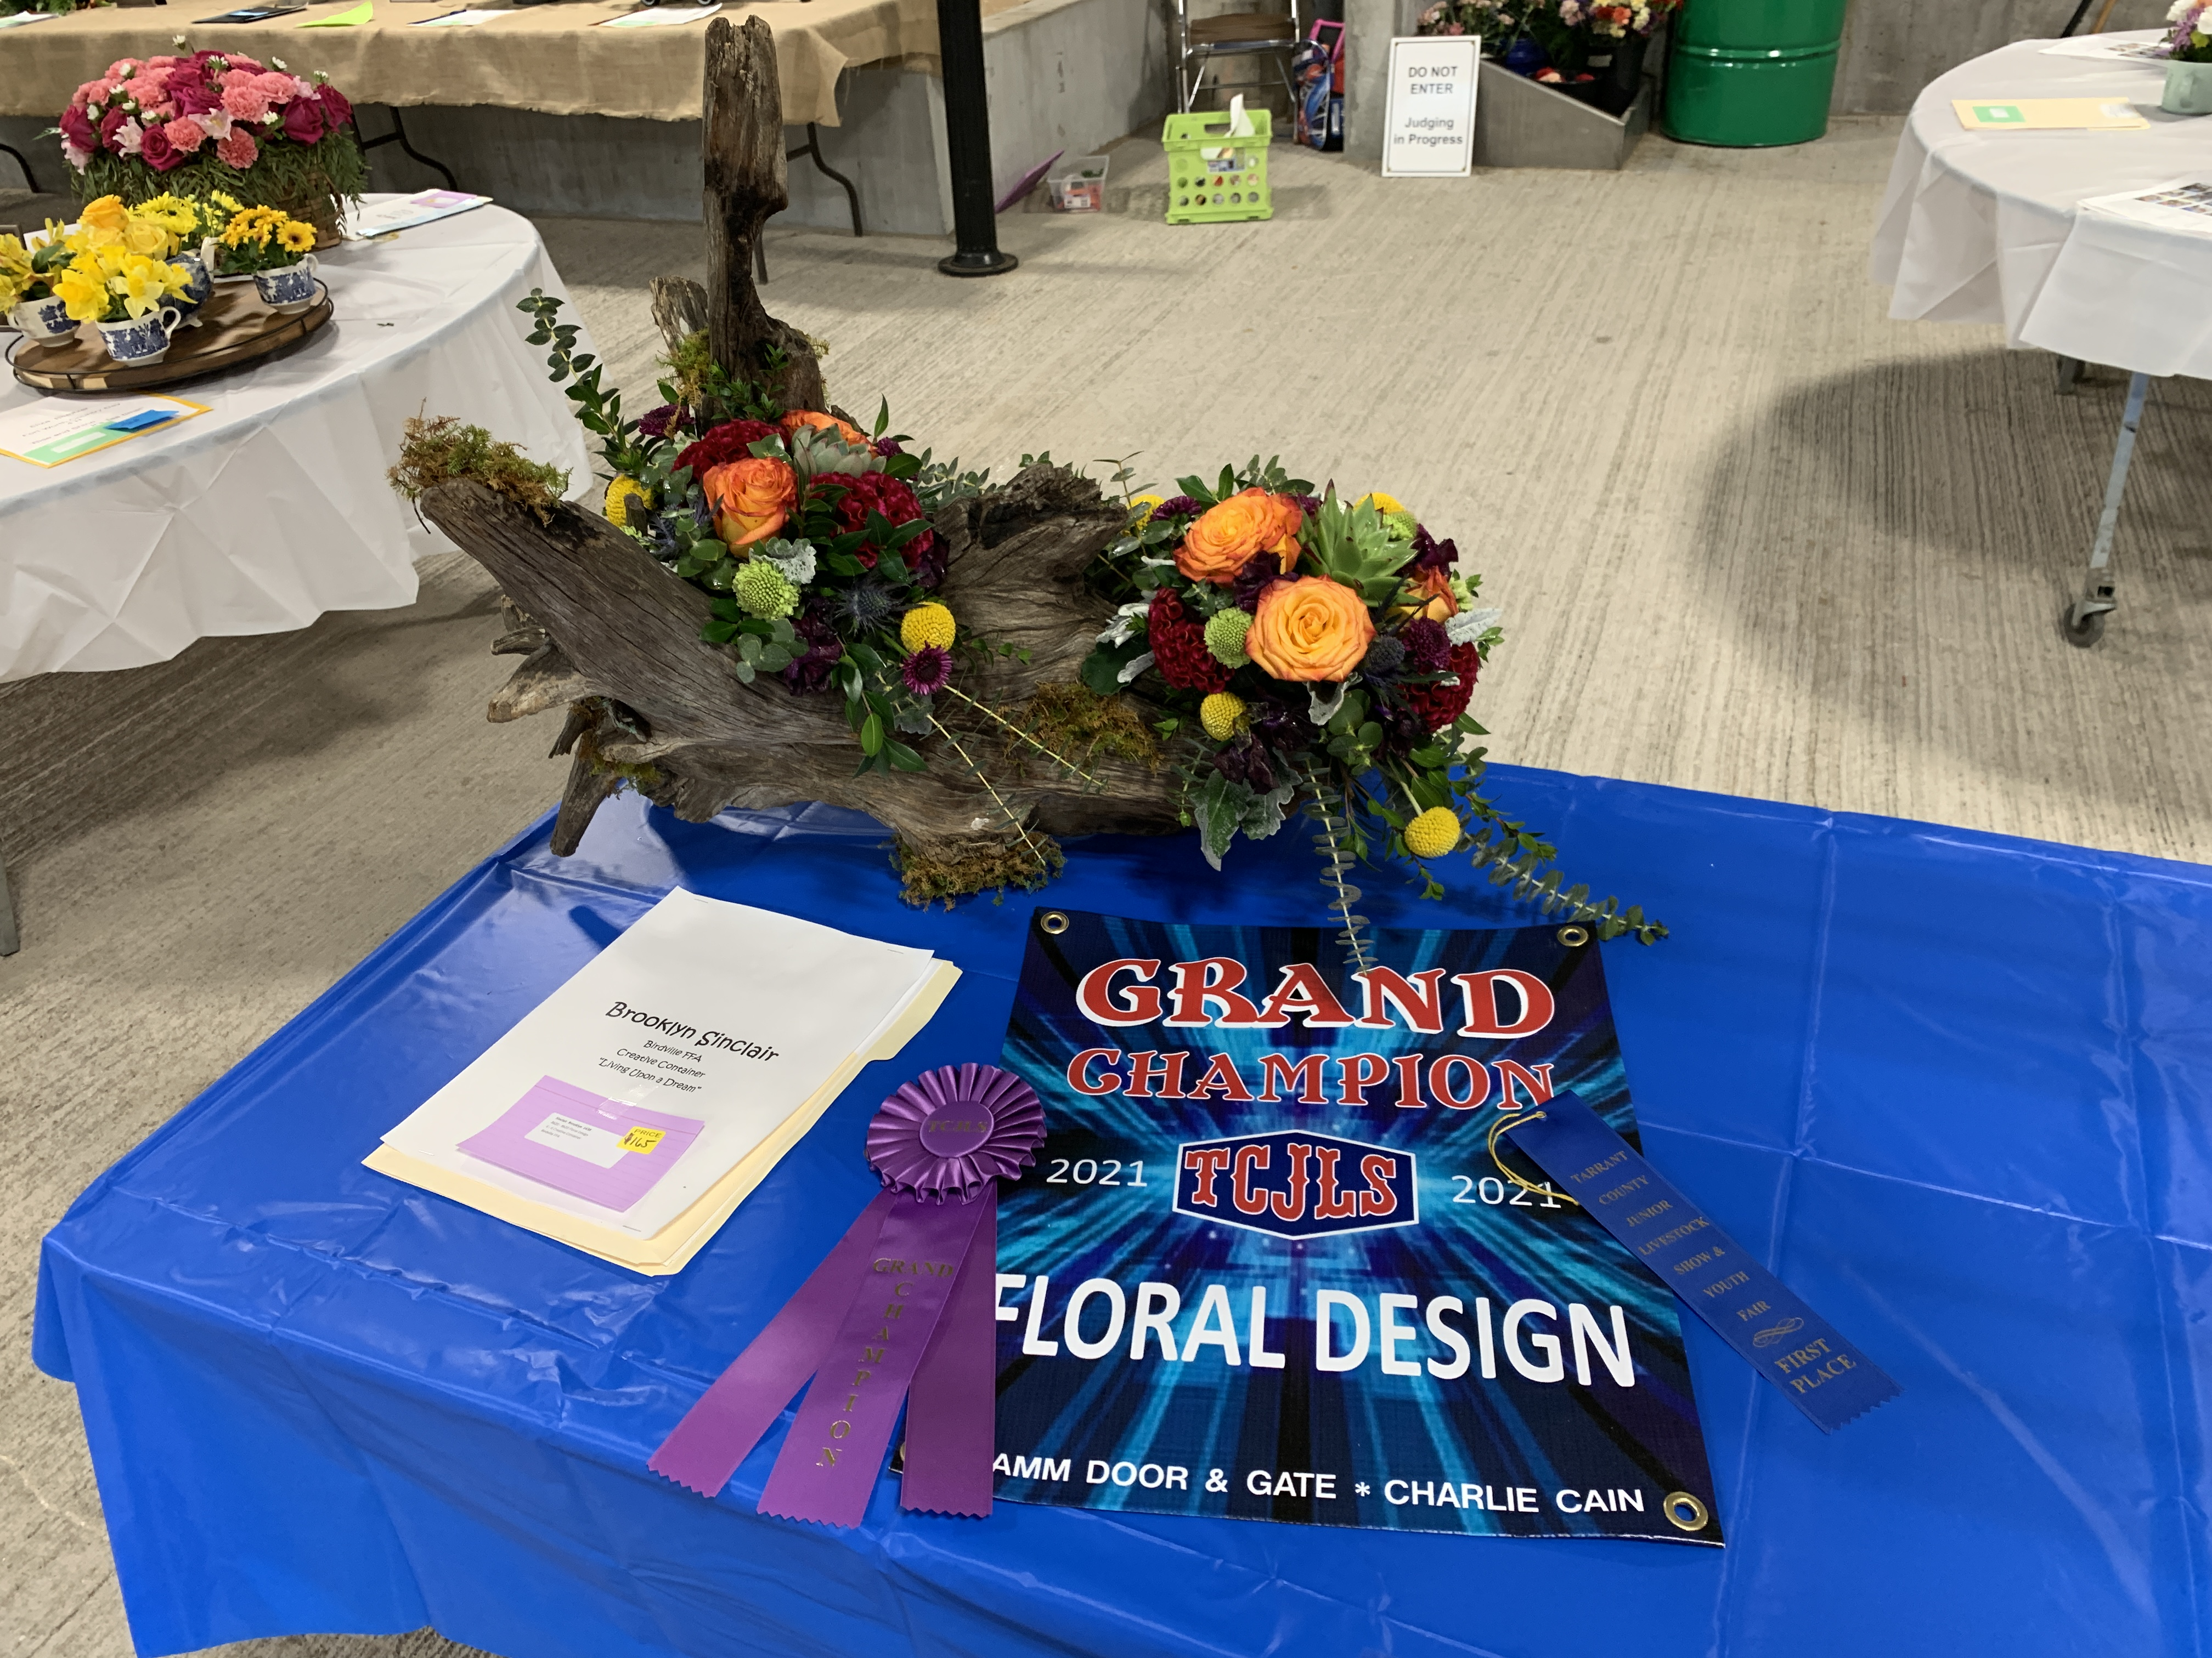
Tarrant County Jr. Livestock Show and Youth fair
Floral- 100 participants
Horticulture- 60 to 70 participants
Categories
Awards
Scholarships and Sale
Adding Competition Event

Slide 3
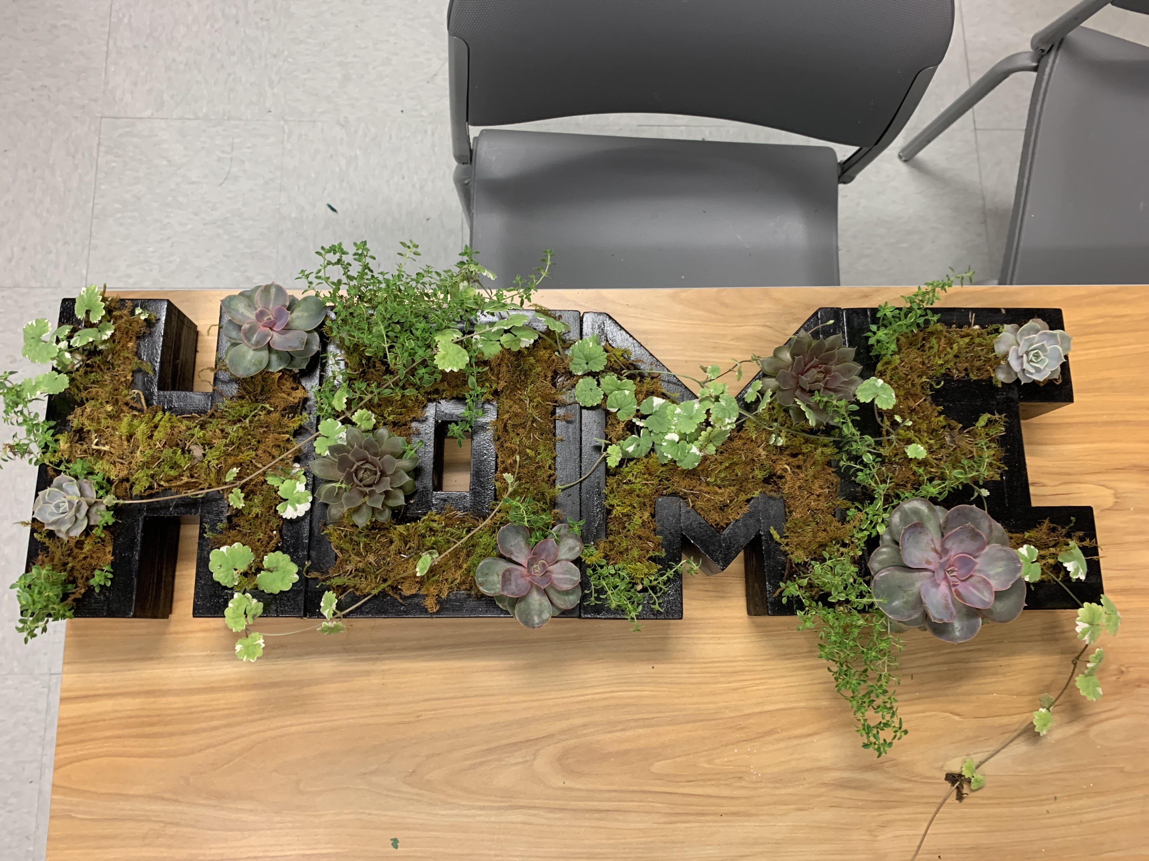
How to we help?
Horticulture
Excuse from class for work days
Allow students to use plants from our greenhouse and keep projects
Floral
Trip to wholesaler
Excuse from class for work days
Cost of greenery

